Slide 1
Image Captioning
Show and Tell
Show, Attend, and Tell
DenseCap
Based on Karpathy’s talk on Image Captioning

Slide 2
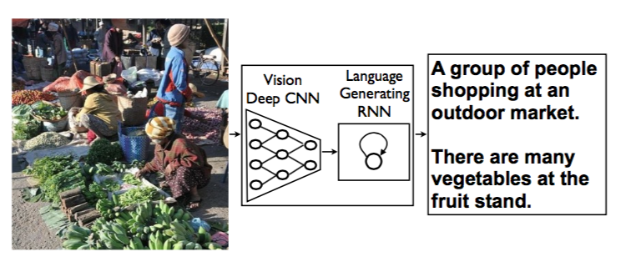
Image Captioning?

Slide 3
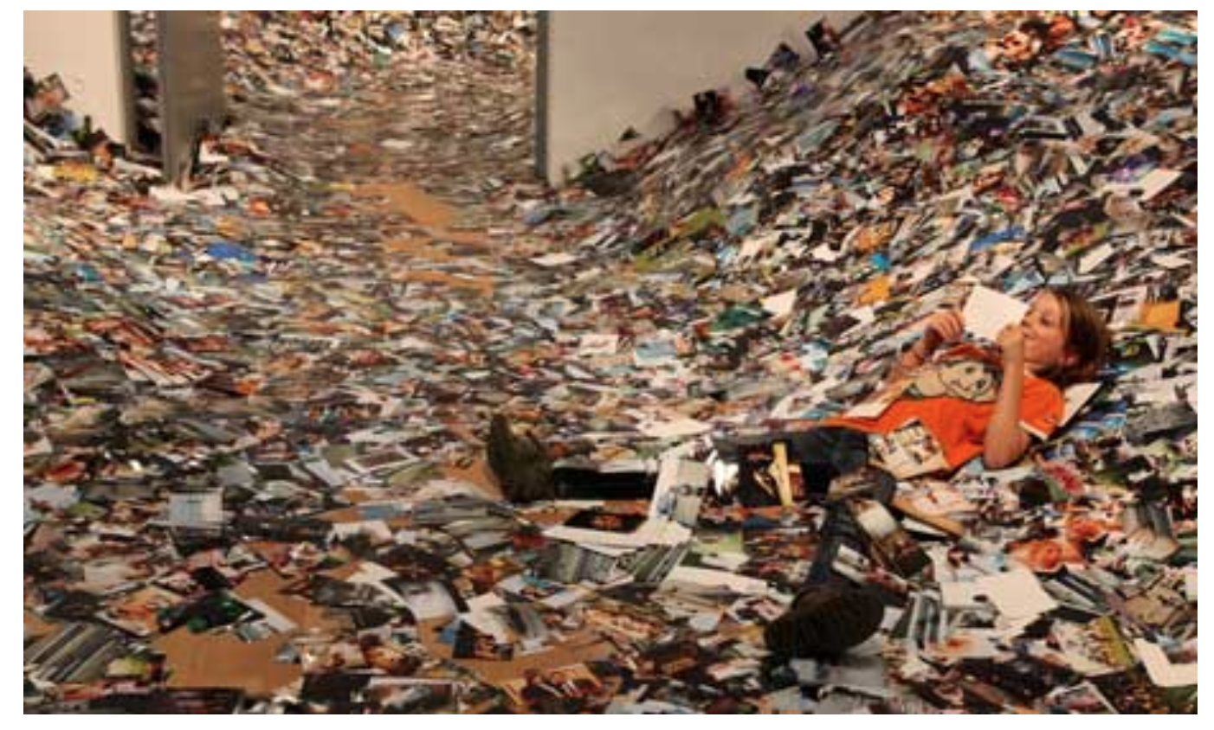
Why Image Captioning?

Slide 4

Multi-modal Learning

Slide 5
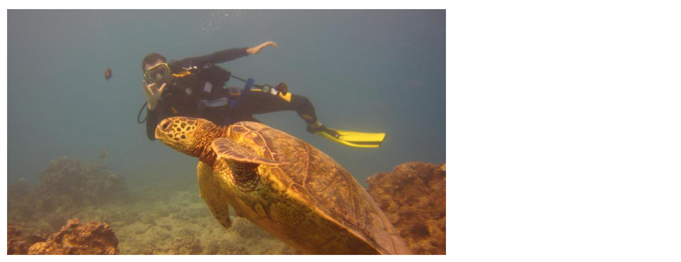
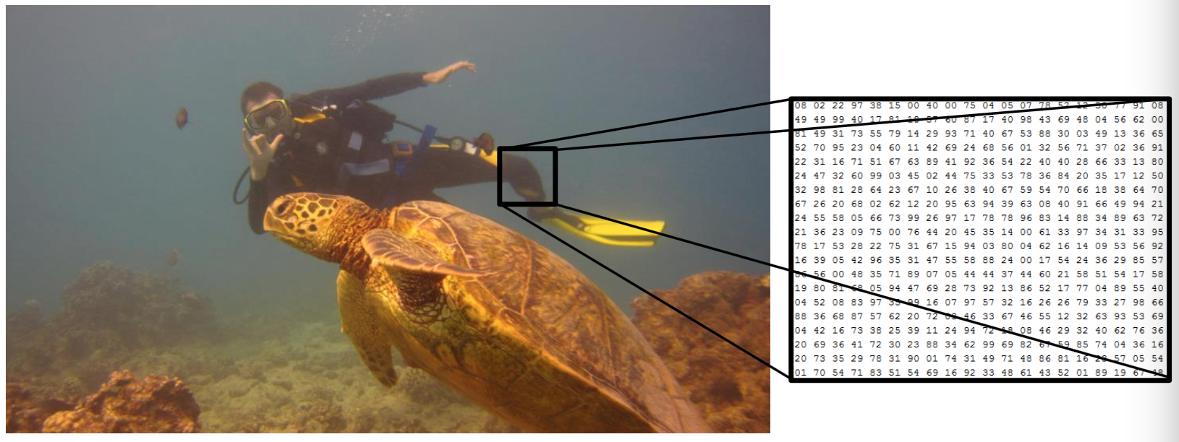
Is it Easy?

Slide 6
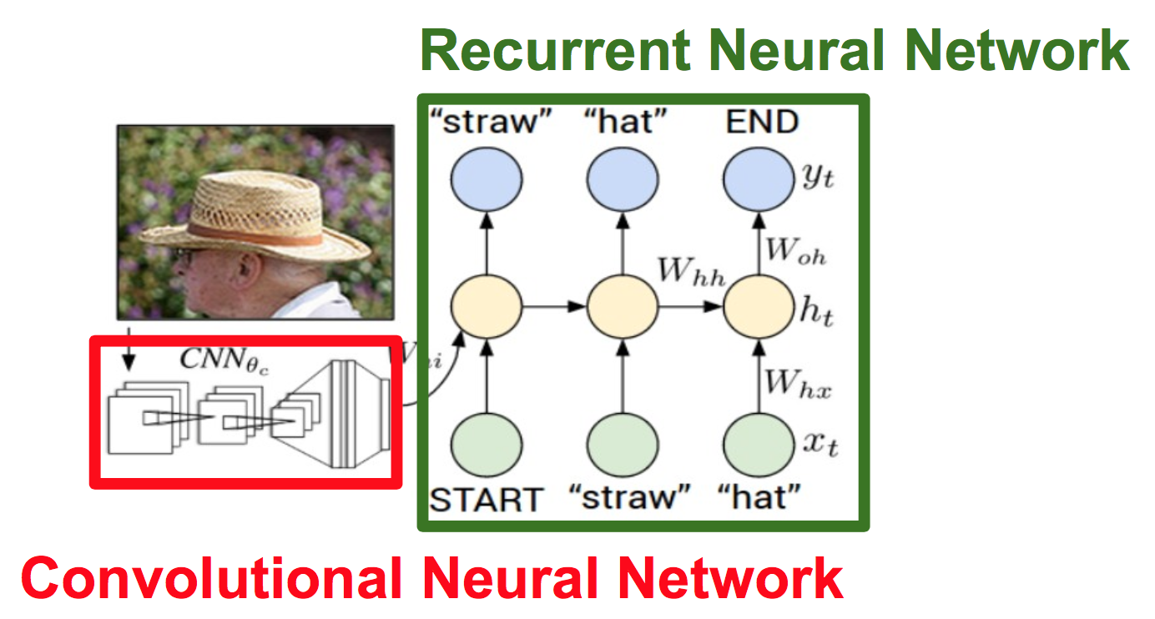
Overall Architecture

Slide 7
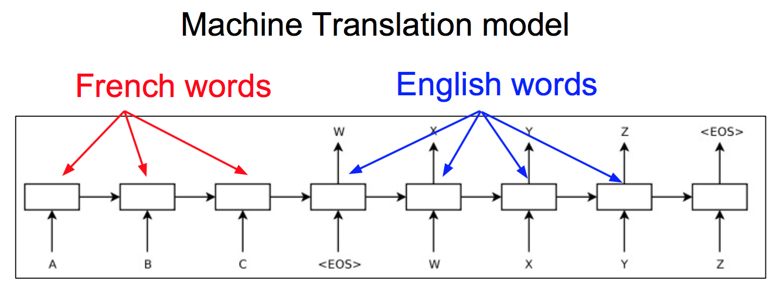
Recurrent Nets

Slide 8
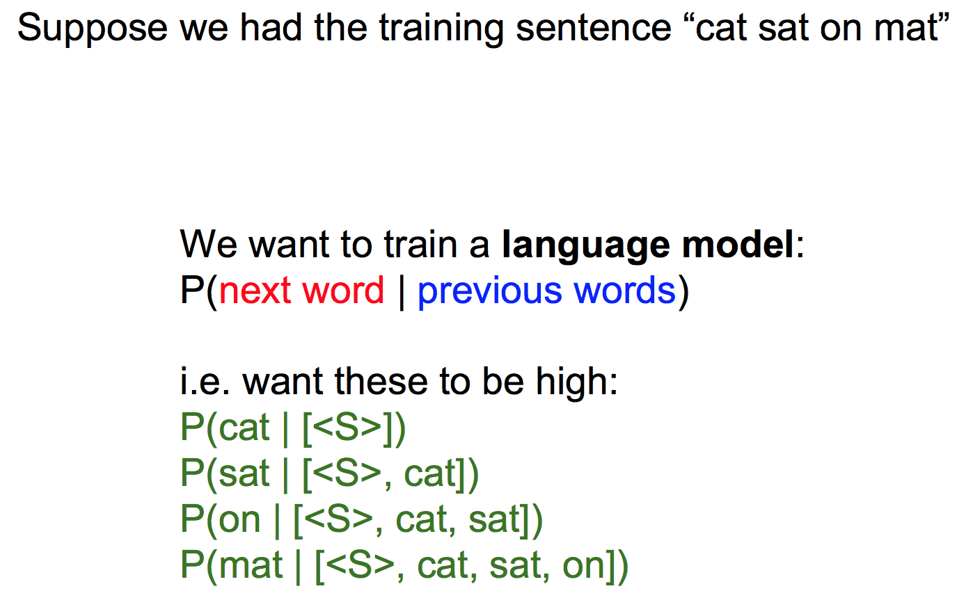
Language Model?

Slide 9
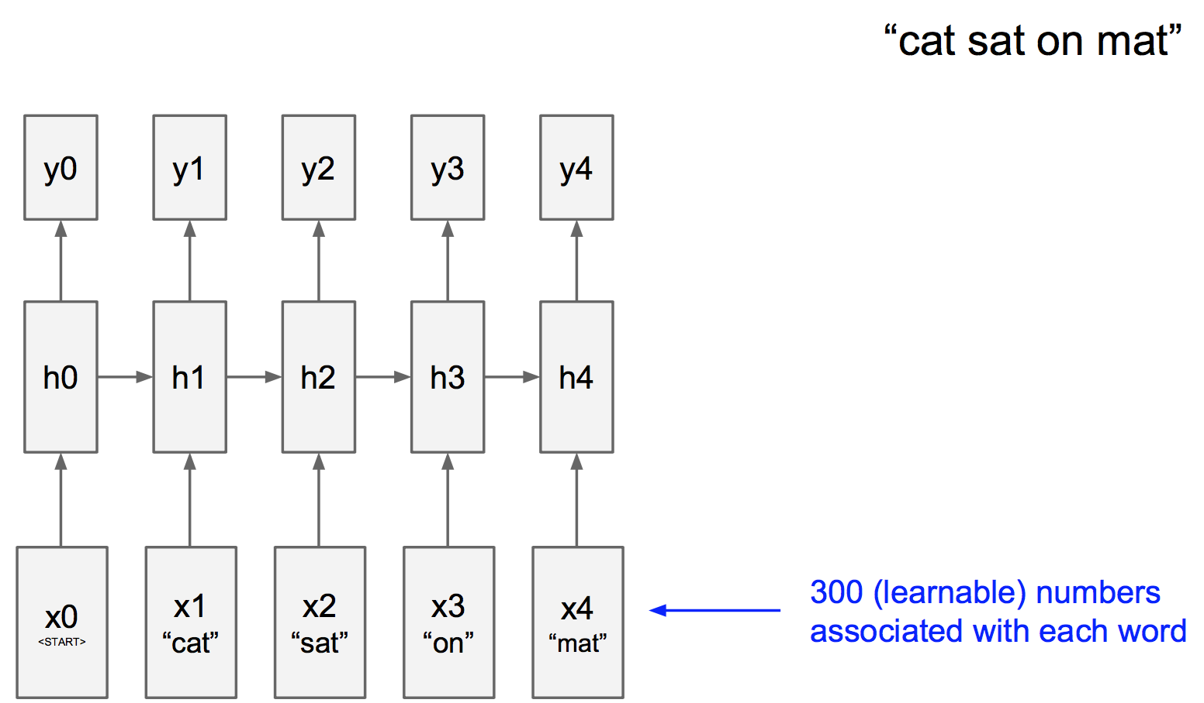
Language Model

Slide 10
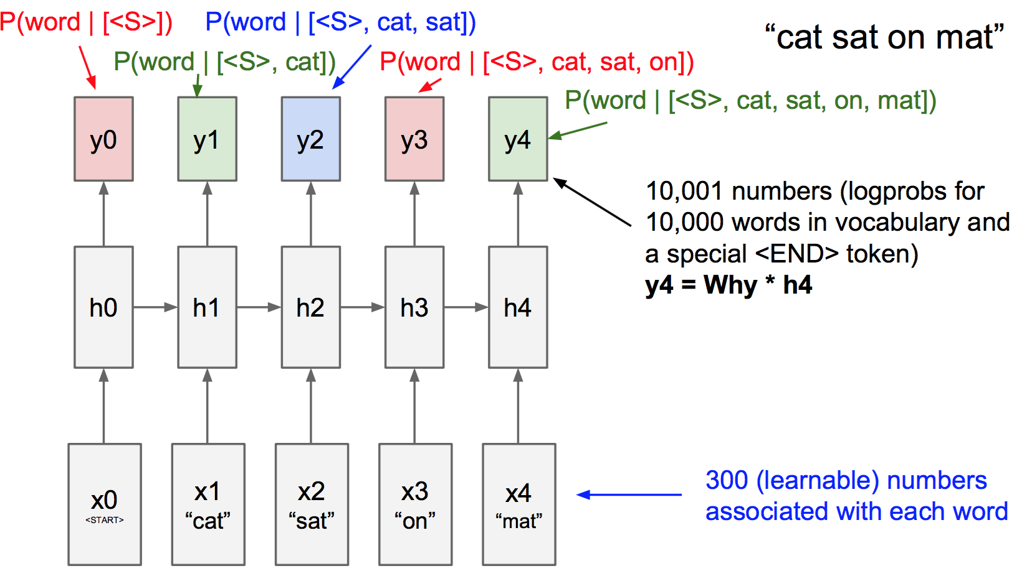
Language Model

Slide 11
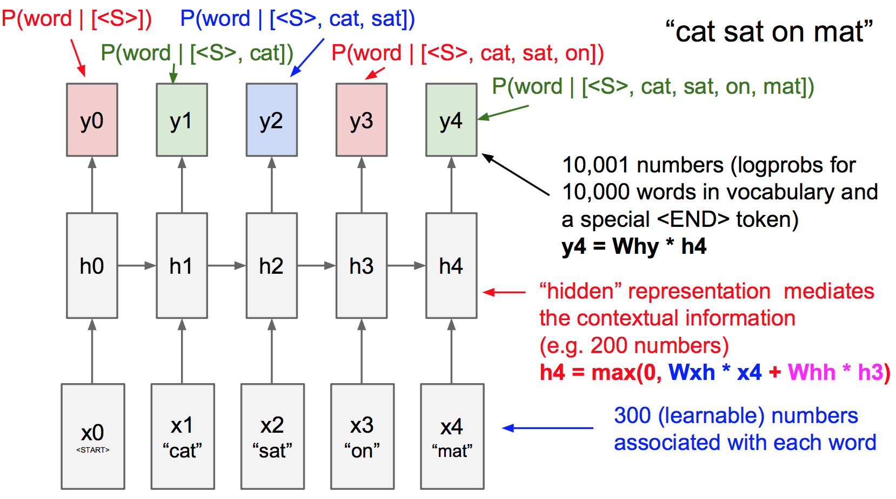
Language Model

Slide 12
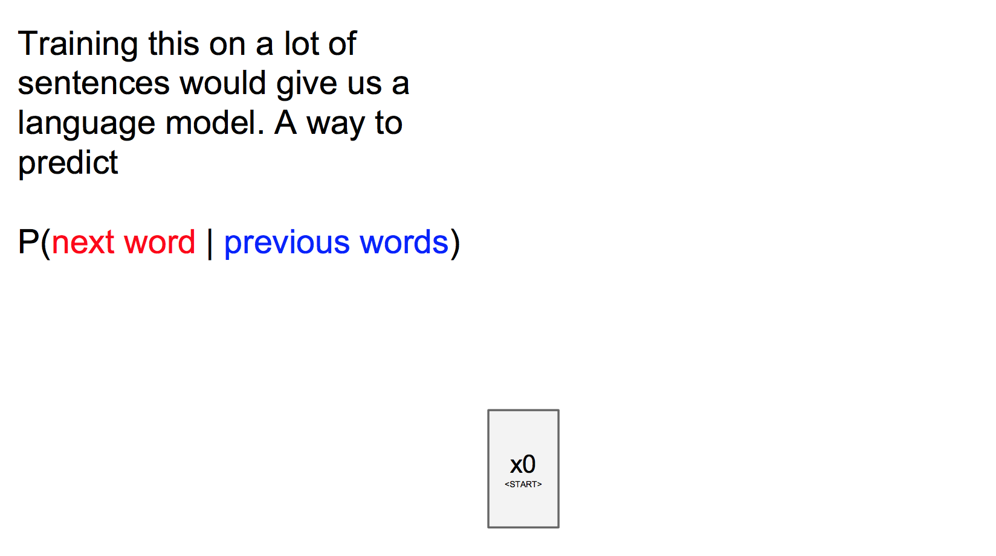
Language Model

Slide 13
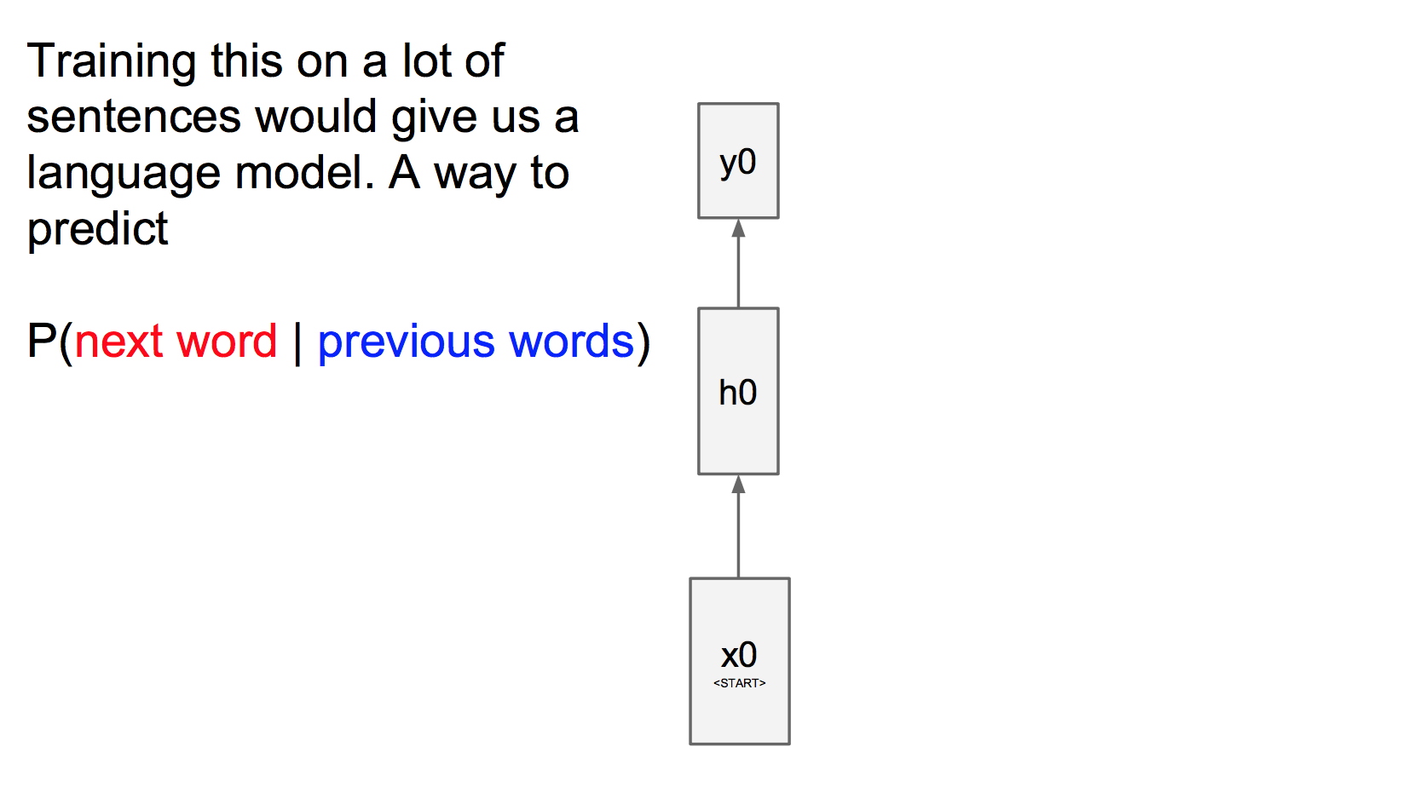
Language Model

Slide 14
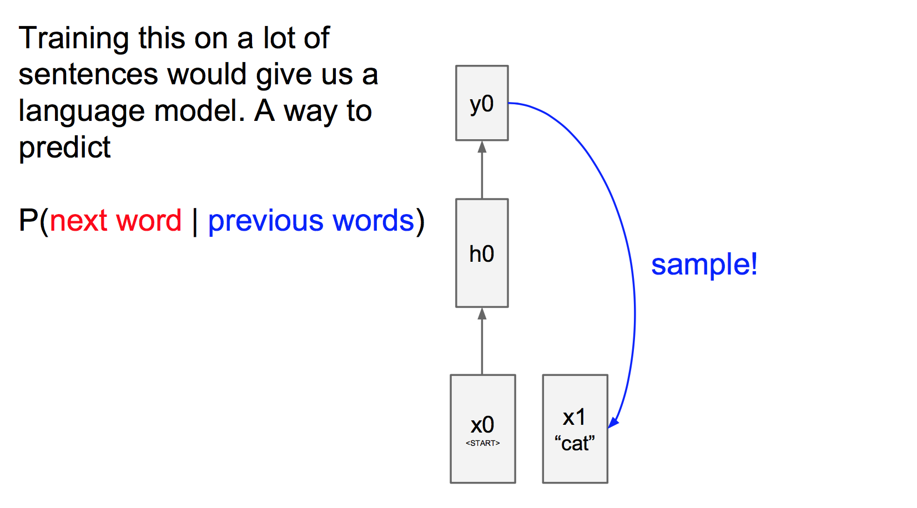
Language Model

Slide 15
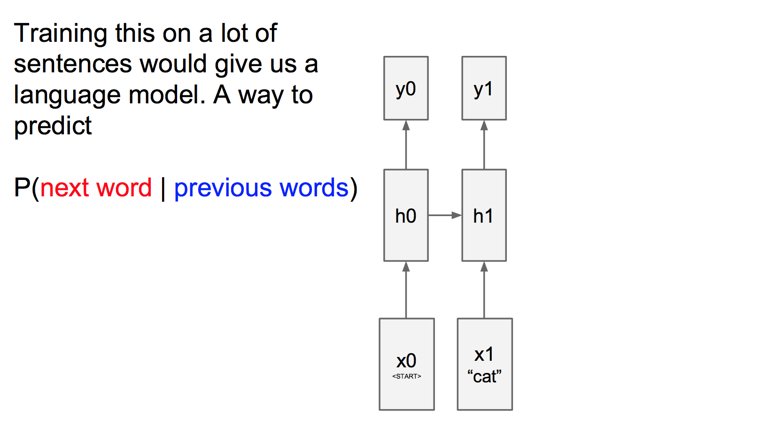
Language Model

Slide 16
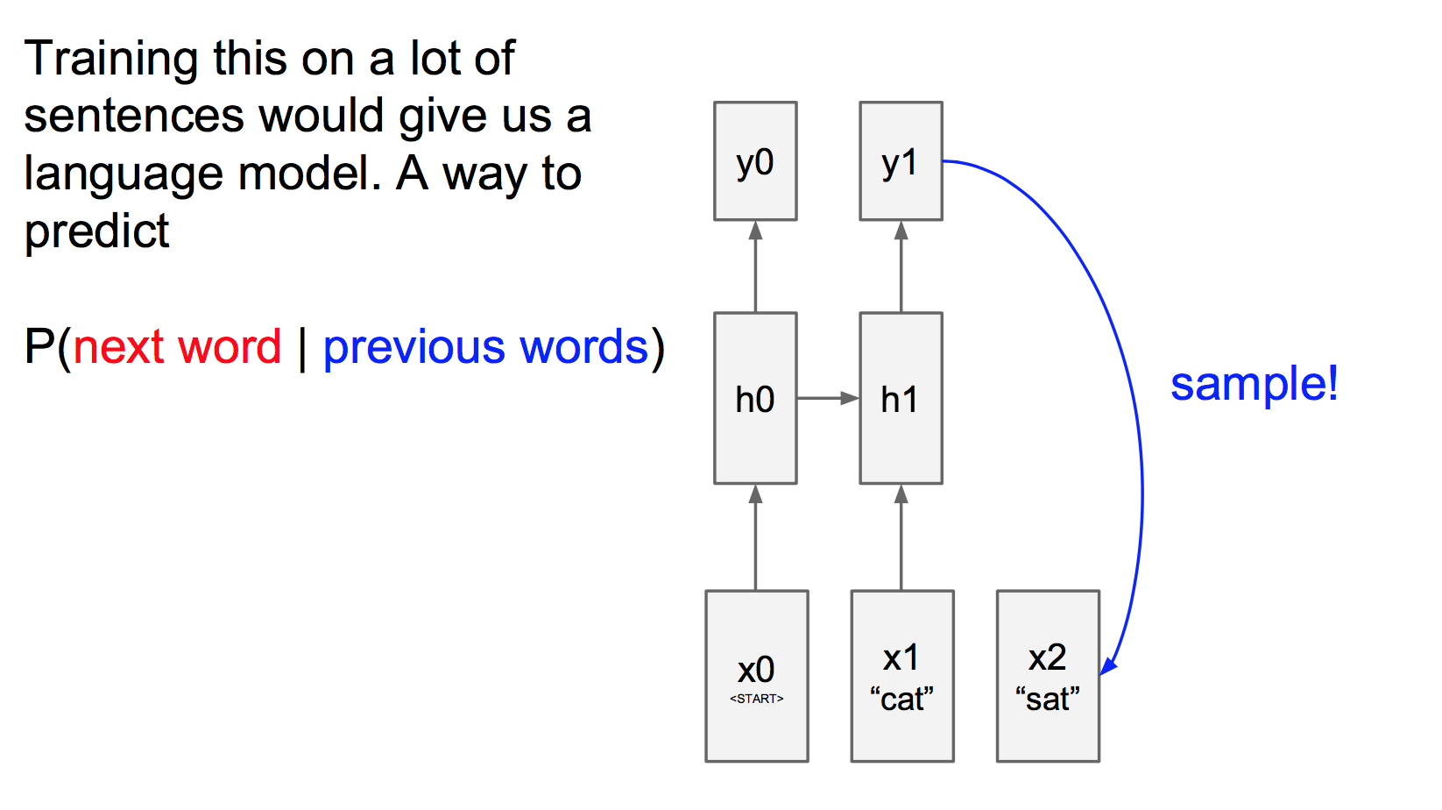
Language Model

Slide 17
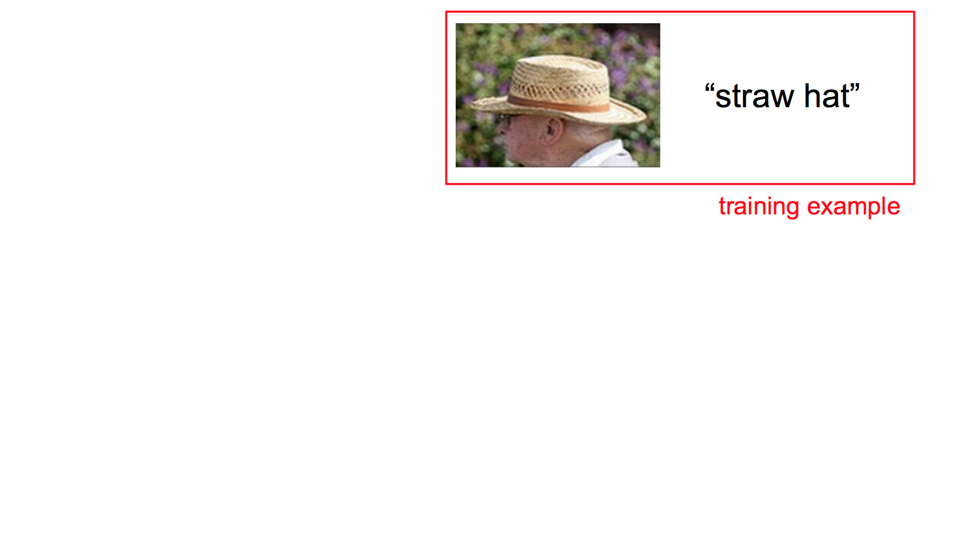
Training phase

Slide 18
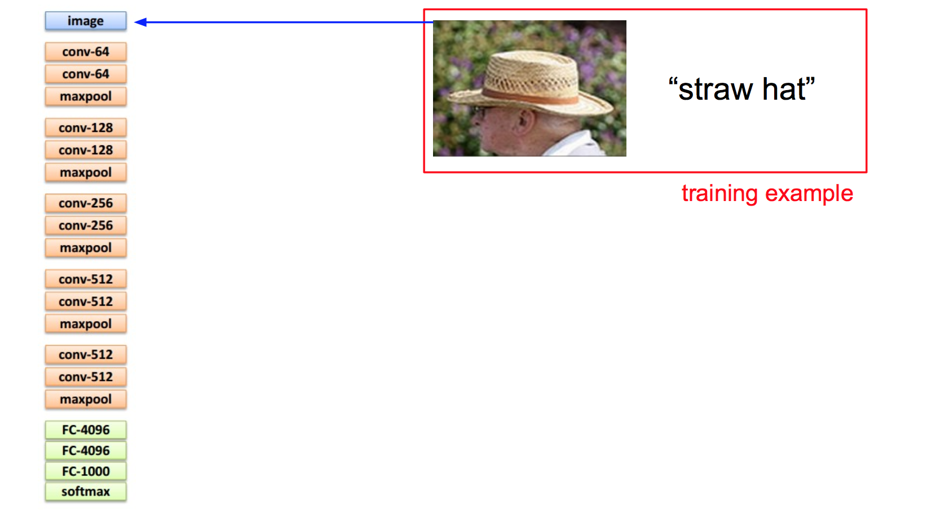
Training phase

Slide 19
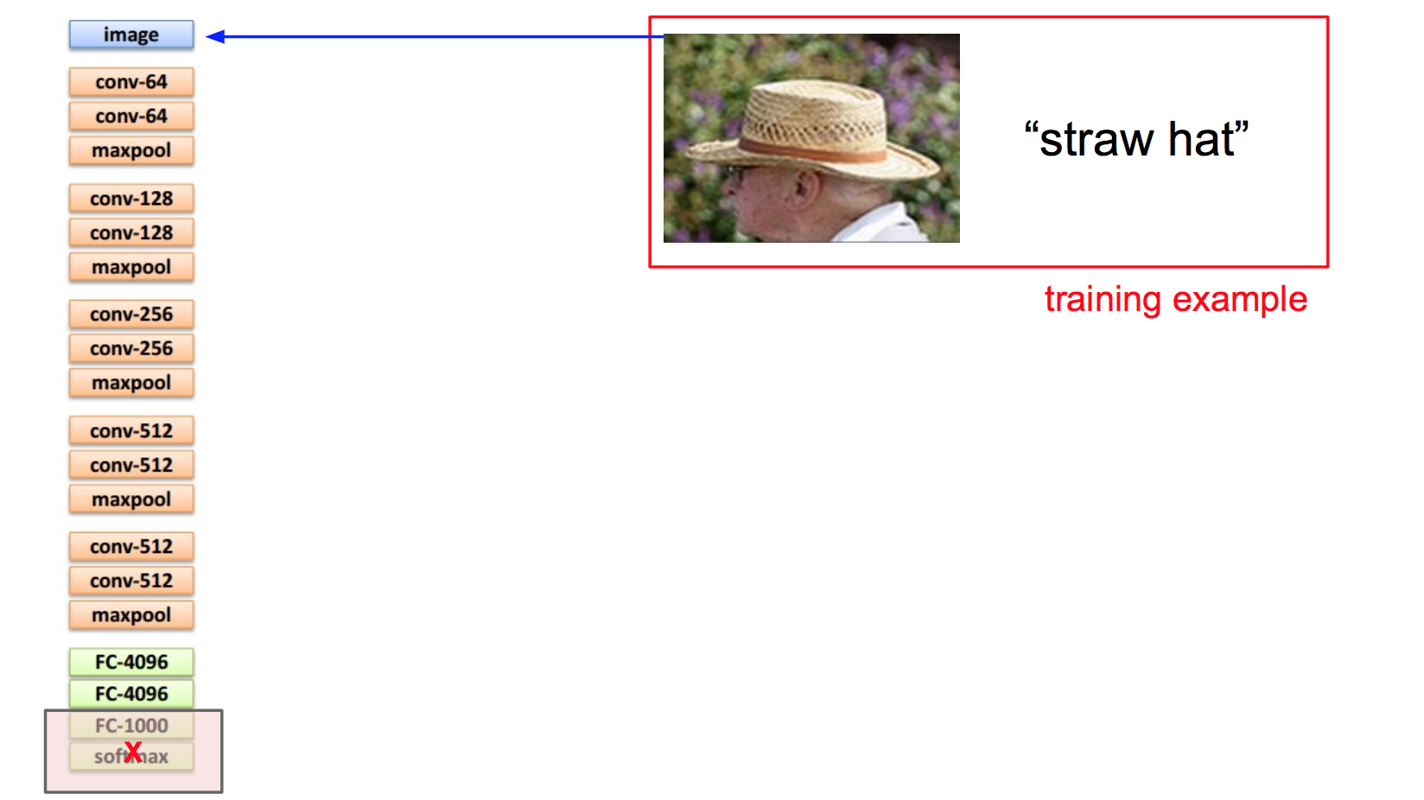
Training phase

Slide 20
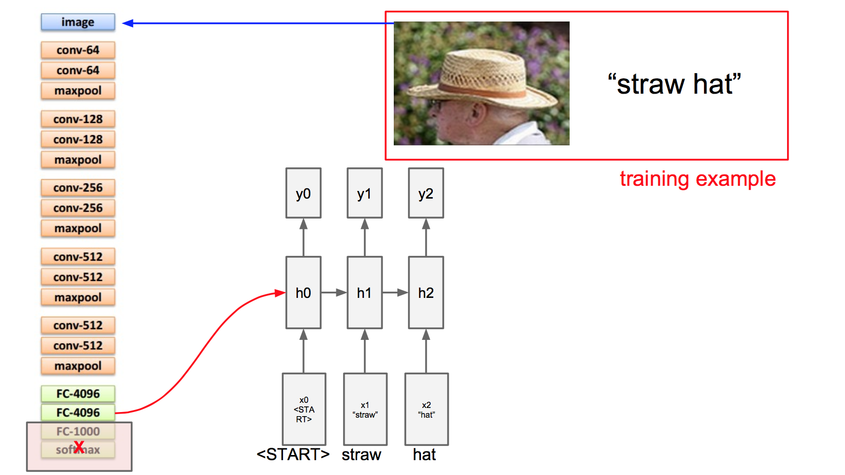
Training phase

Slide 21
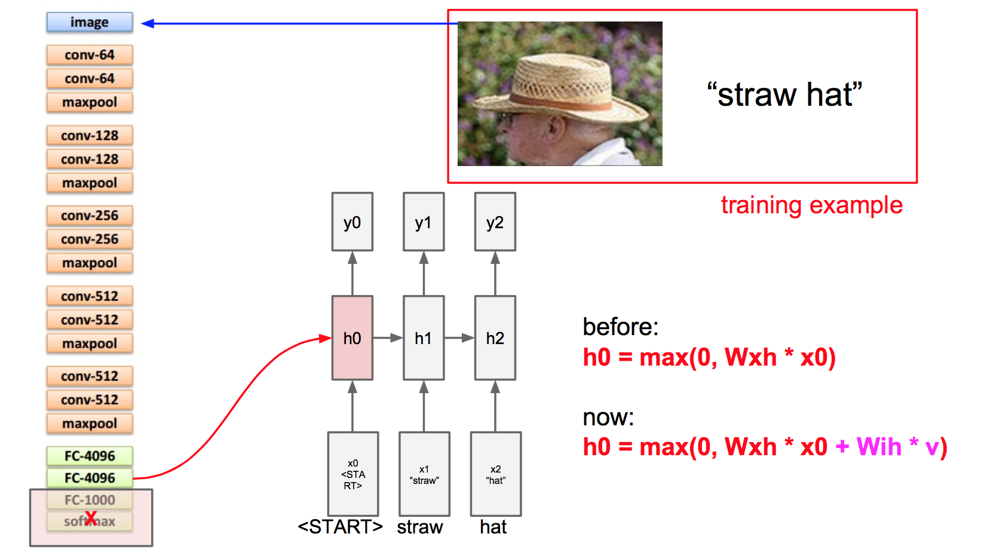
Training phase

Slide 22
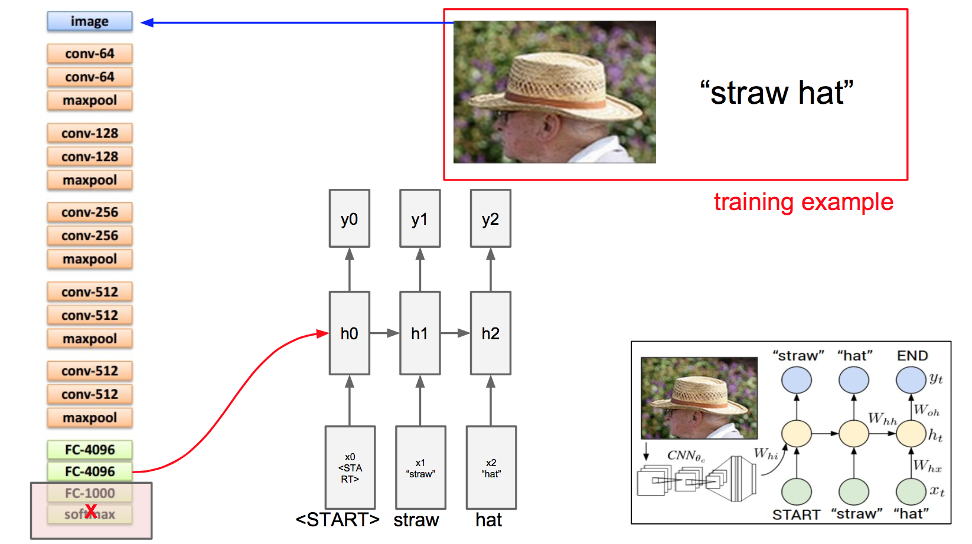
Training phase

Slide 23
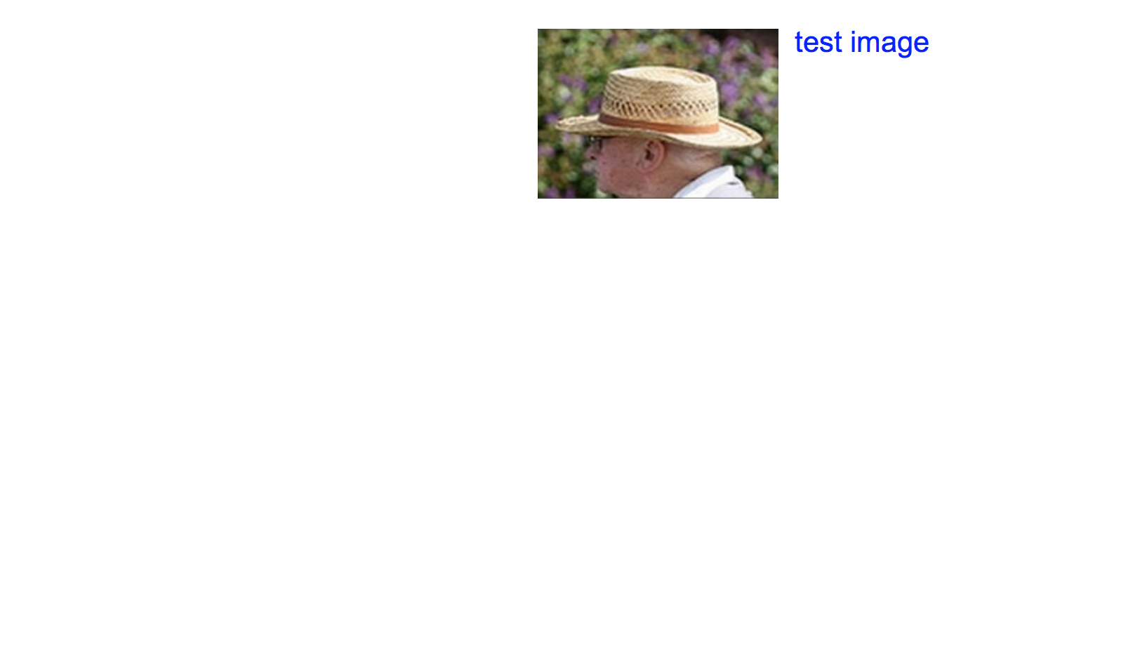
Test phase

Slide 24
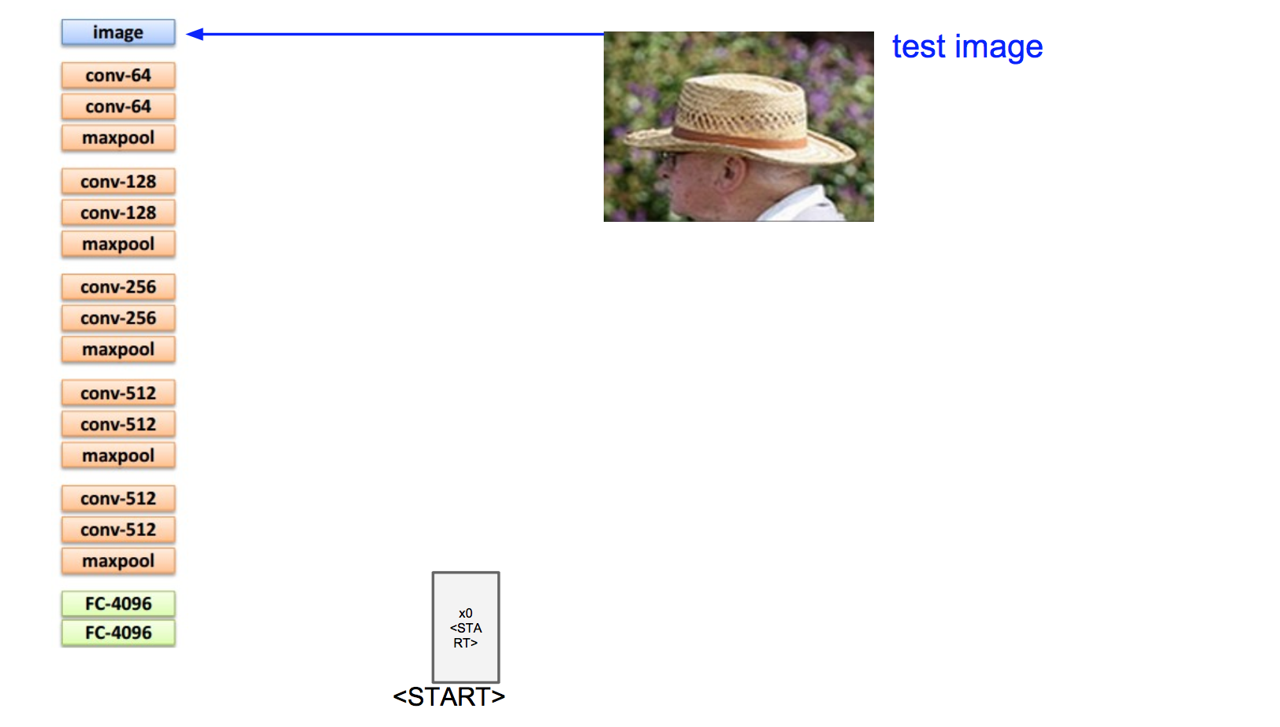
Test phase

Slide 25
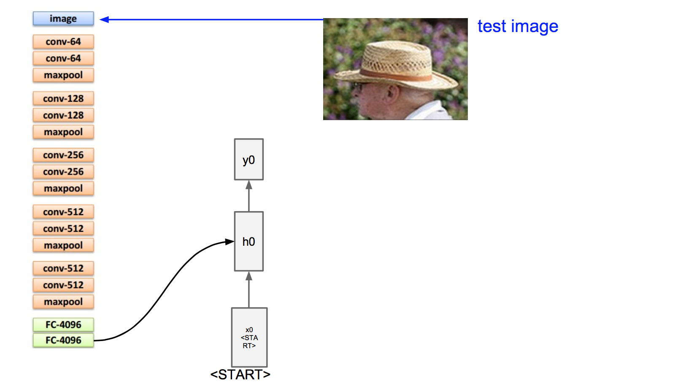
Test phase

Slide 26
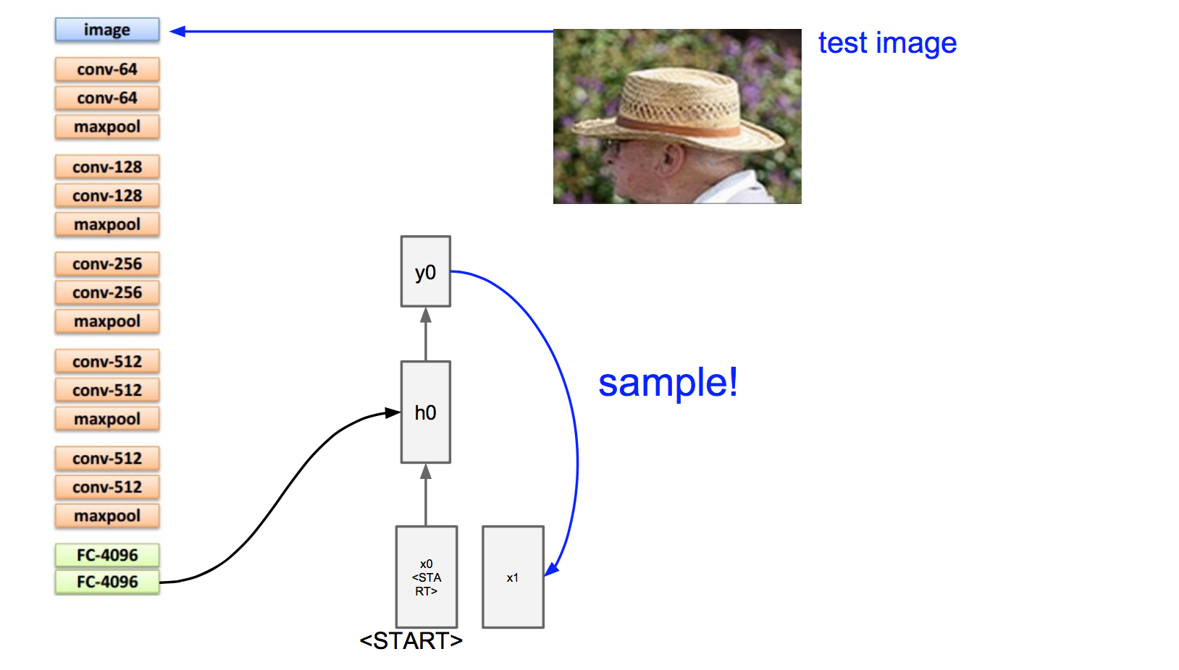
Test phase

Slide 27
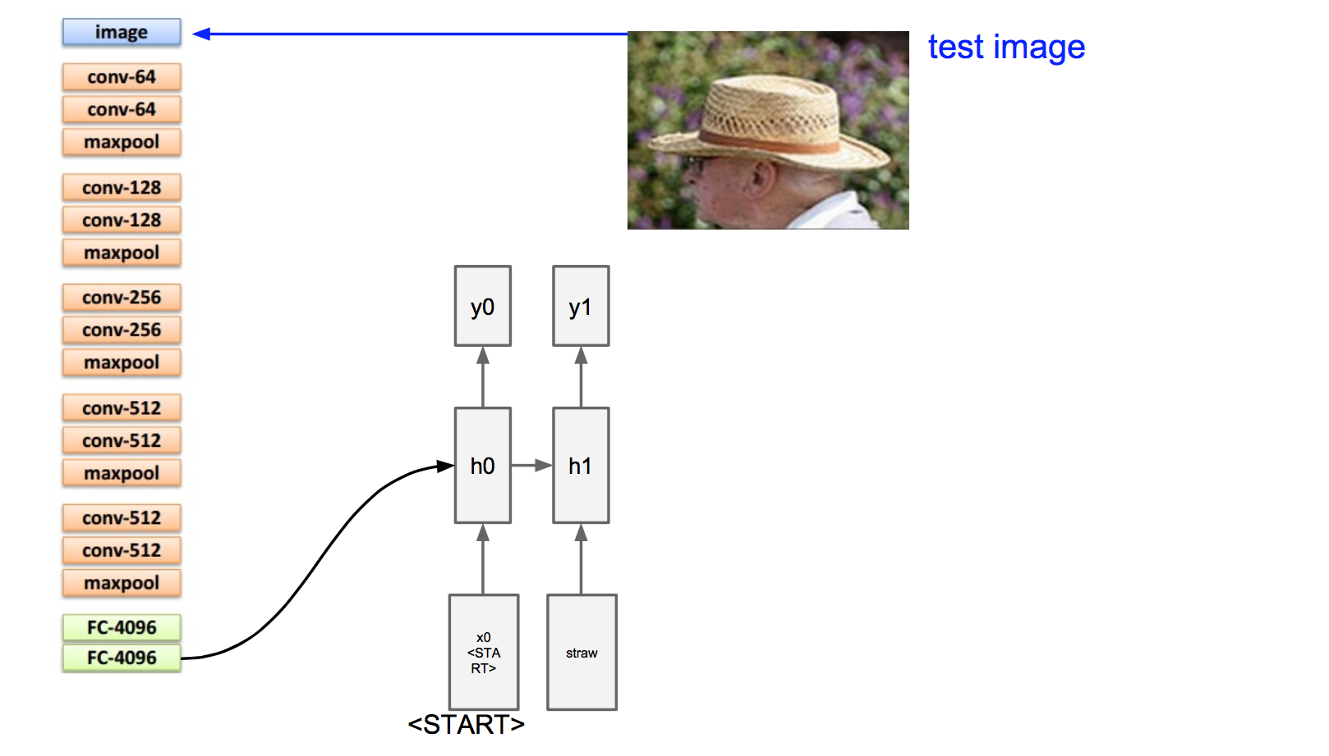
Test phase

Slide 28
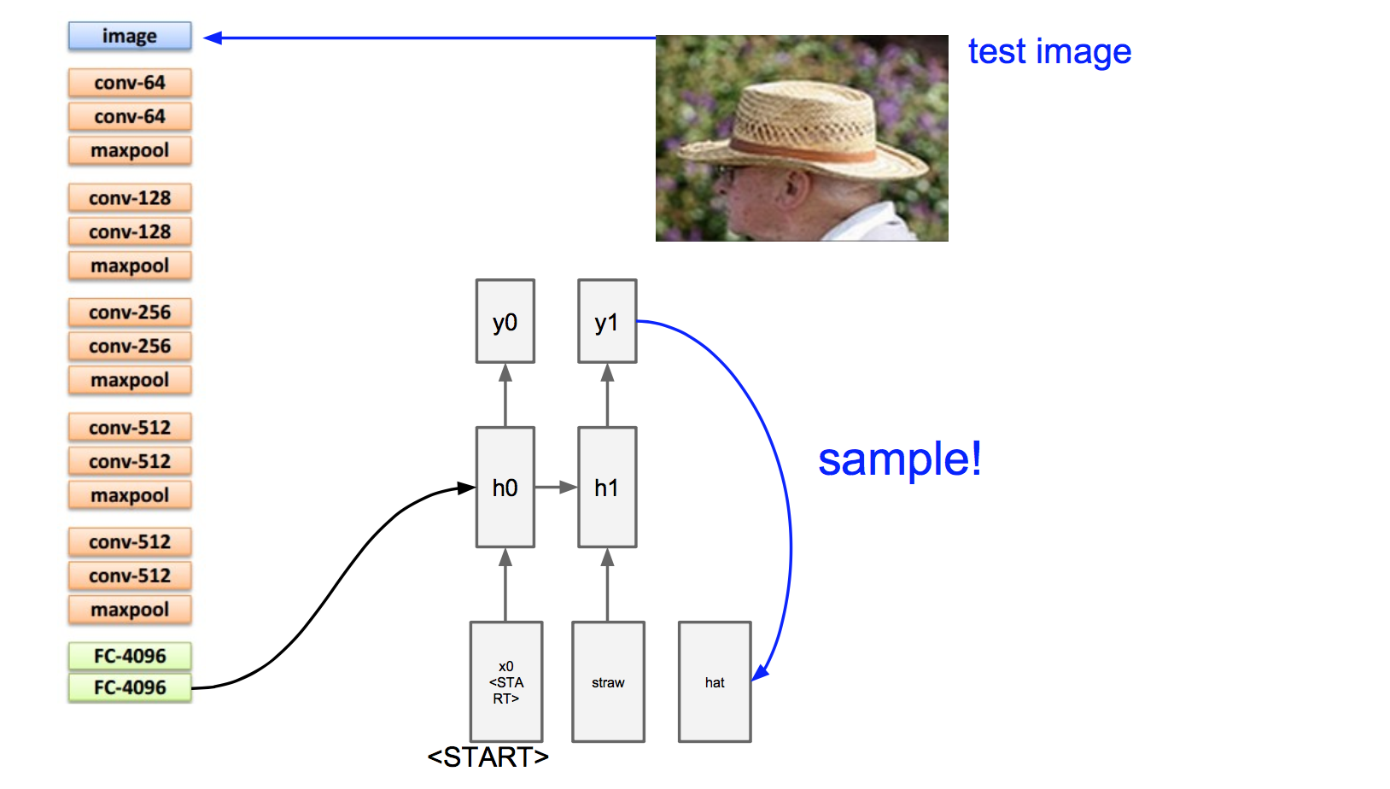
Test phase

Slide 29
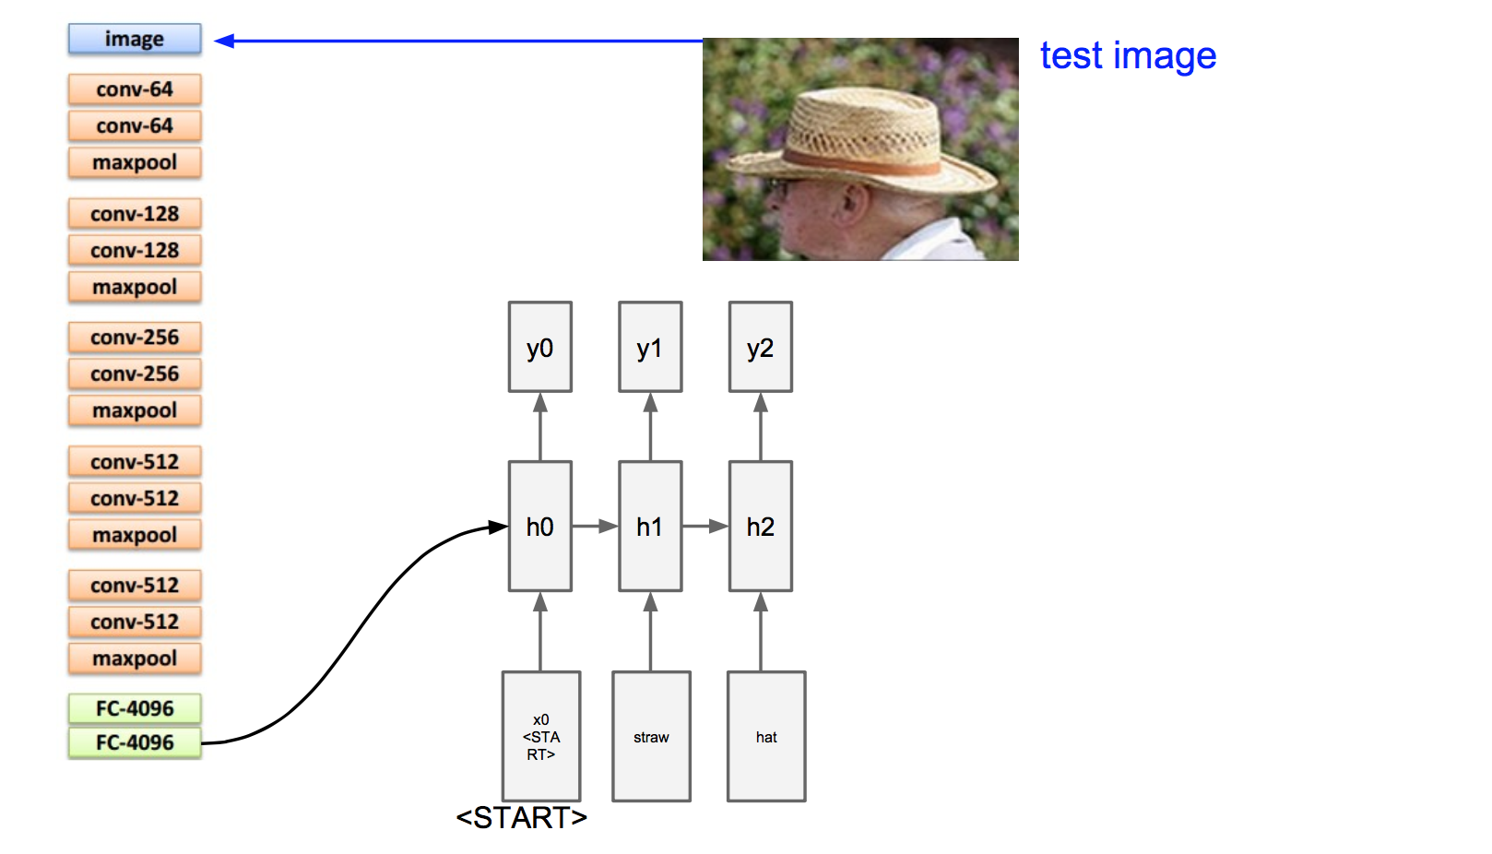
Test phase

Slide 30
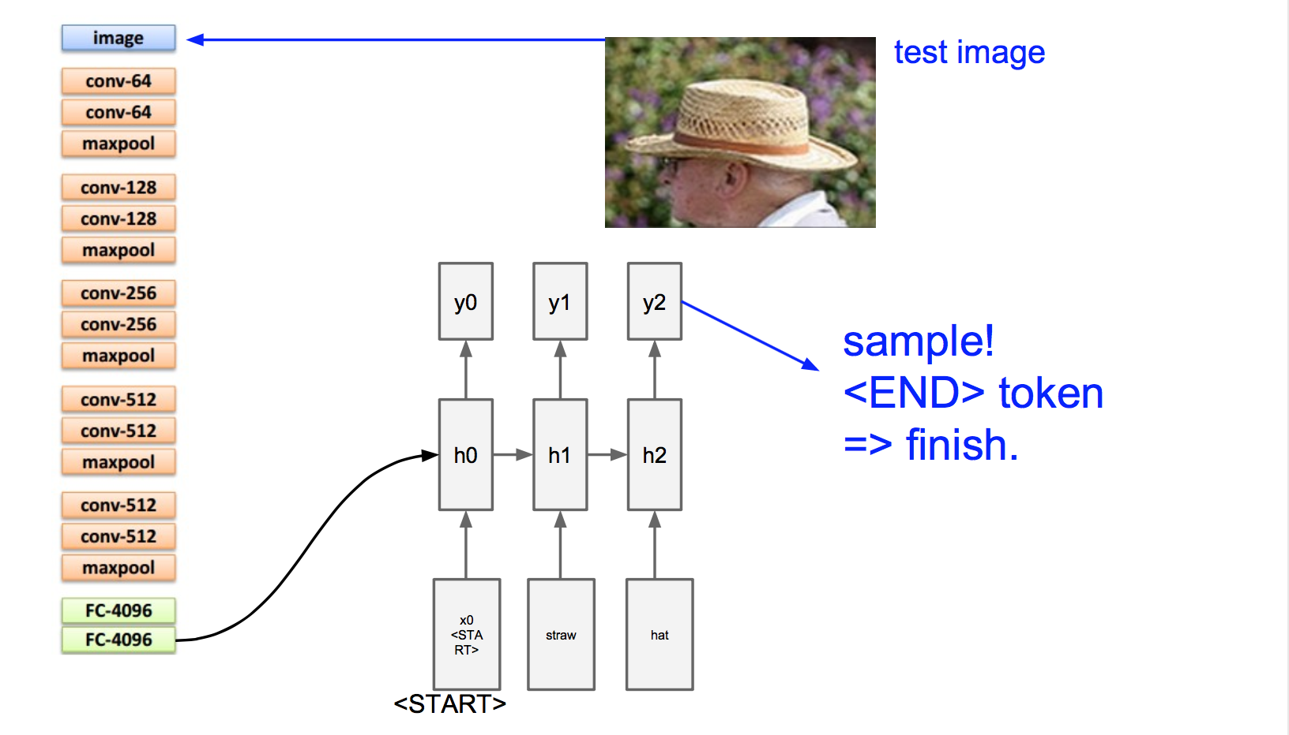
Test phase

Slide 31
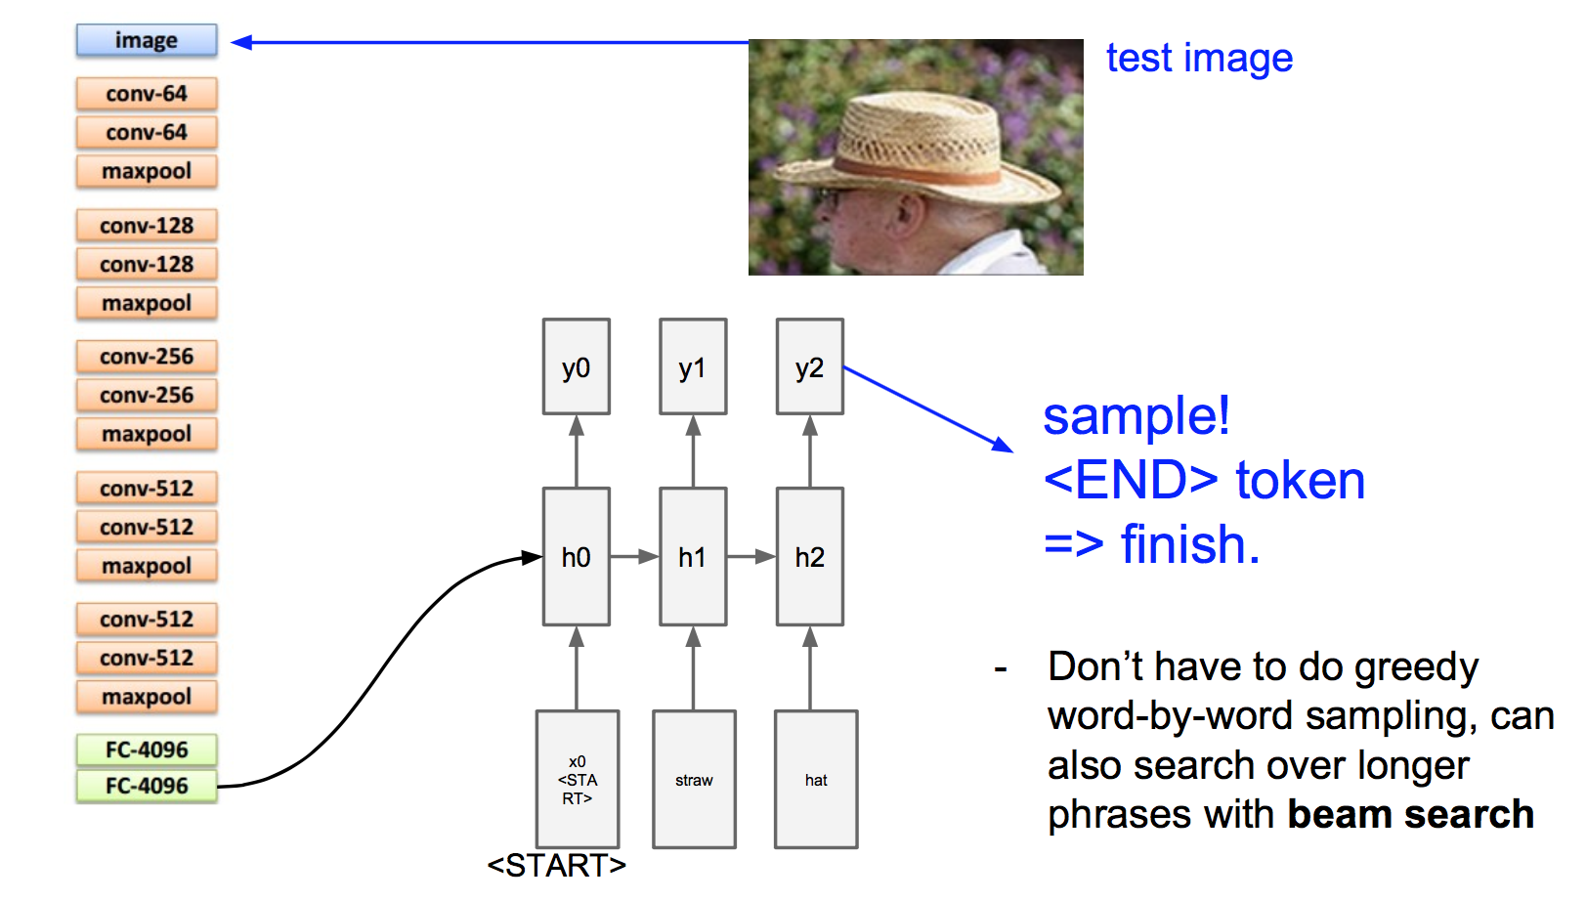
Test phase

Slide 32
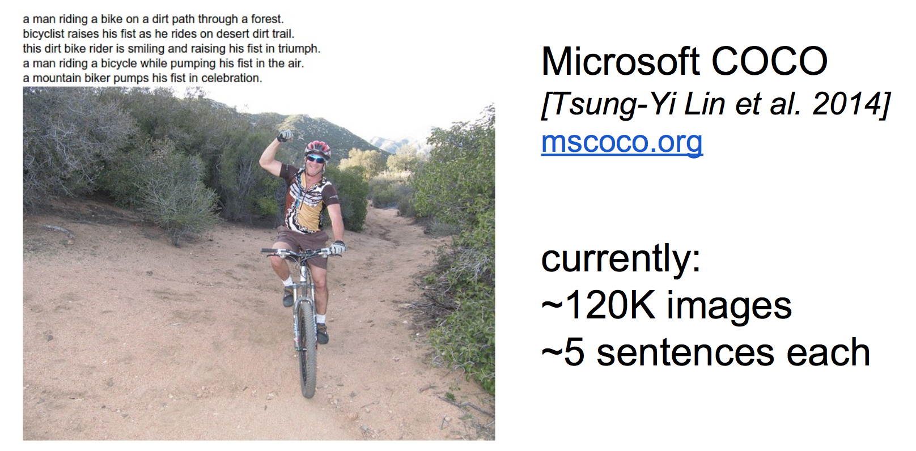
Image Sentence Datasets

Slide 33
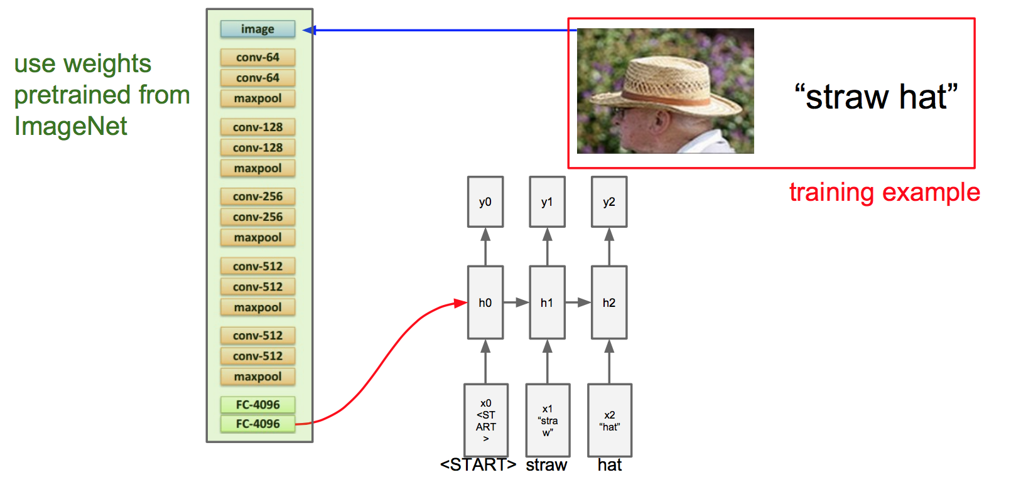
Transfer learning

Slide 34
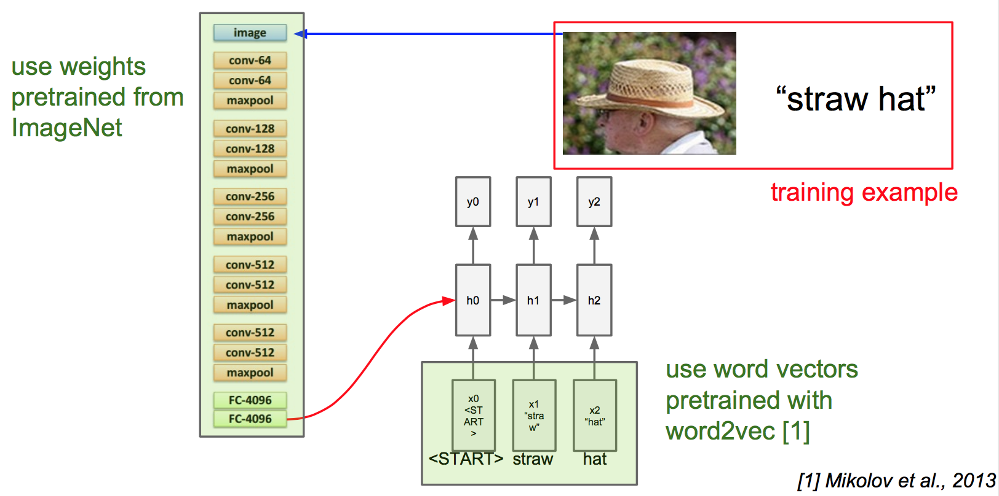
Transfer learning

Slide 35
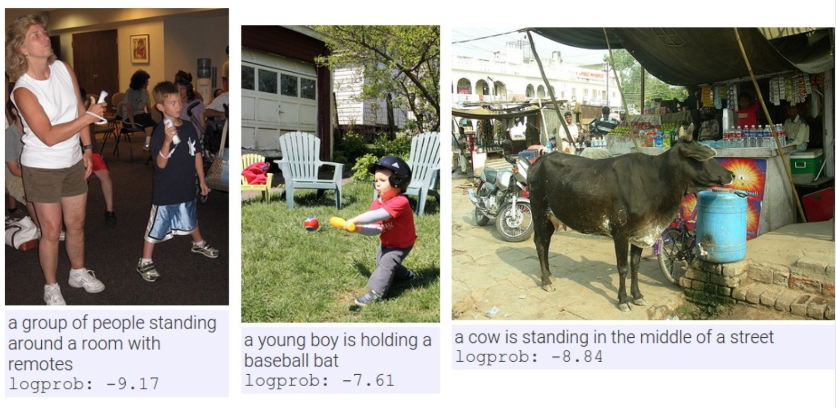
Results

Slide 36
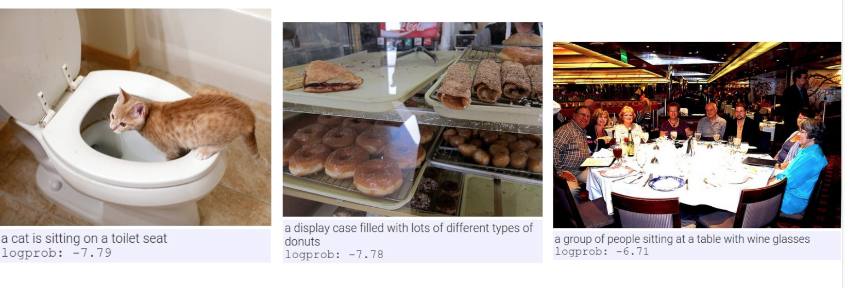
Results

Slide 37
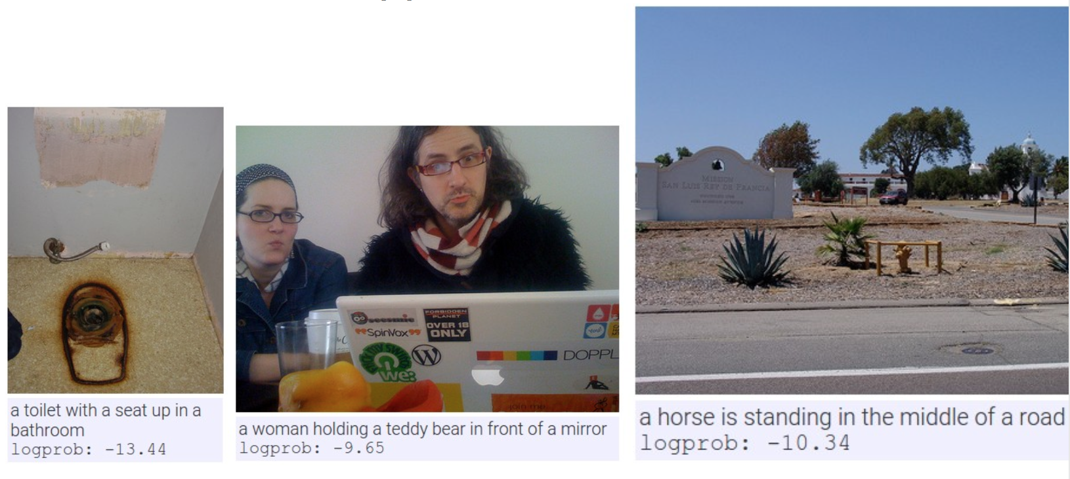
But not always..

Slide 38
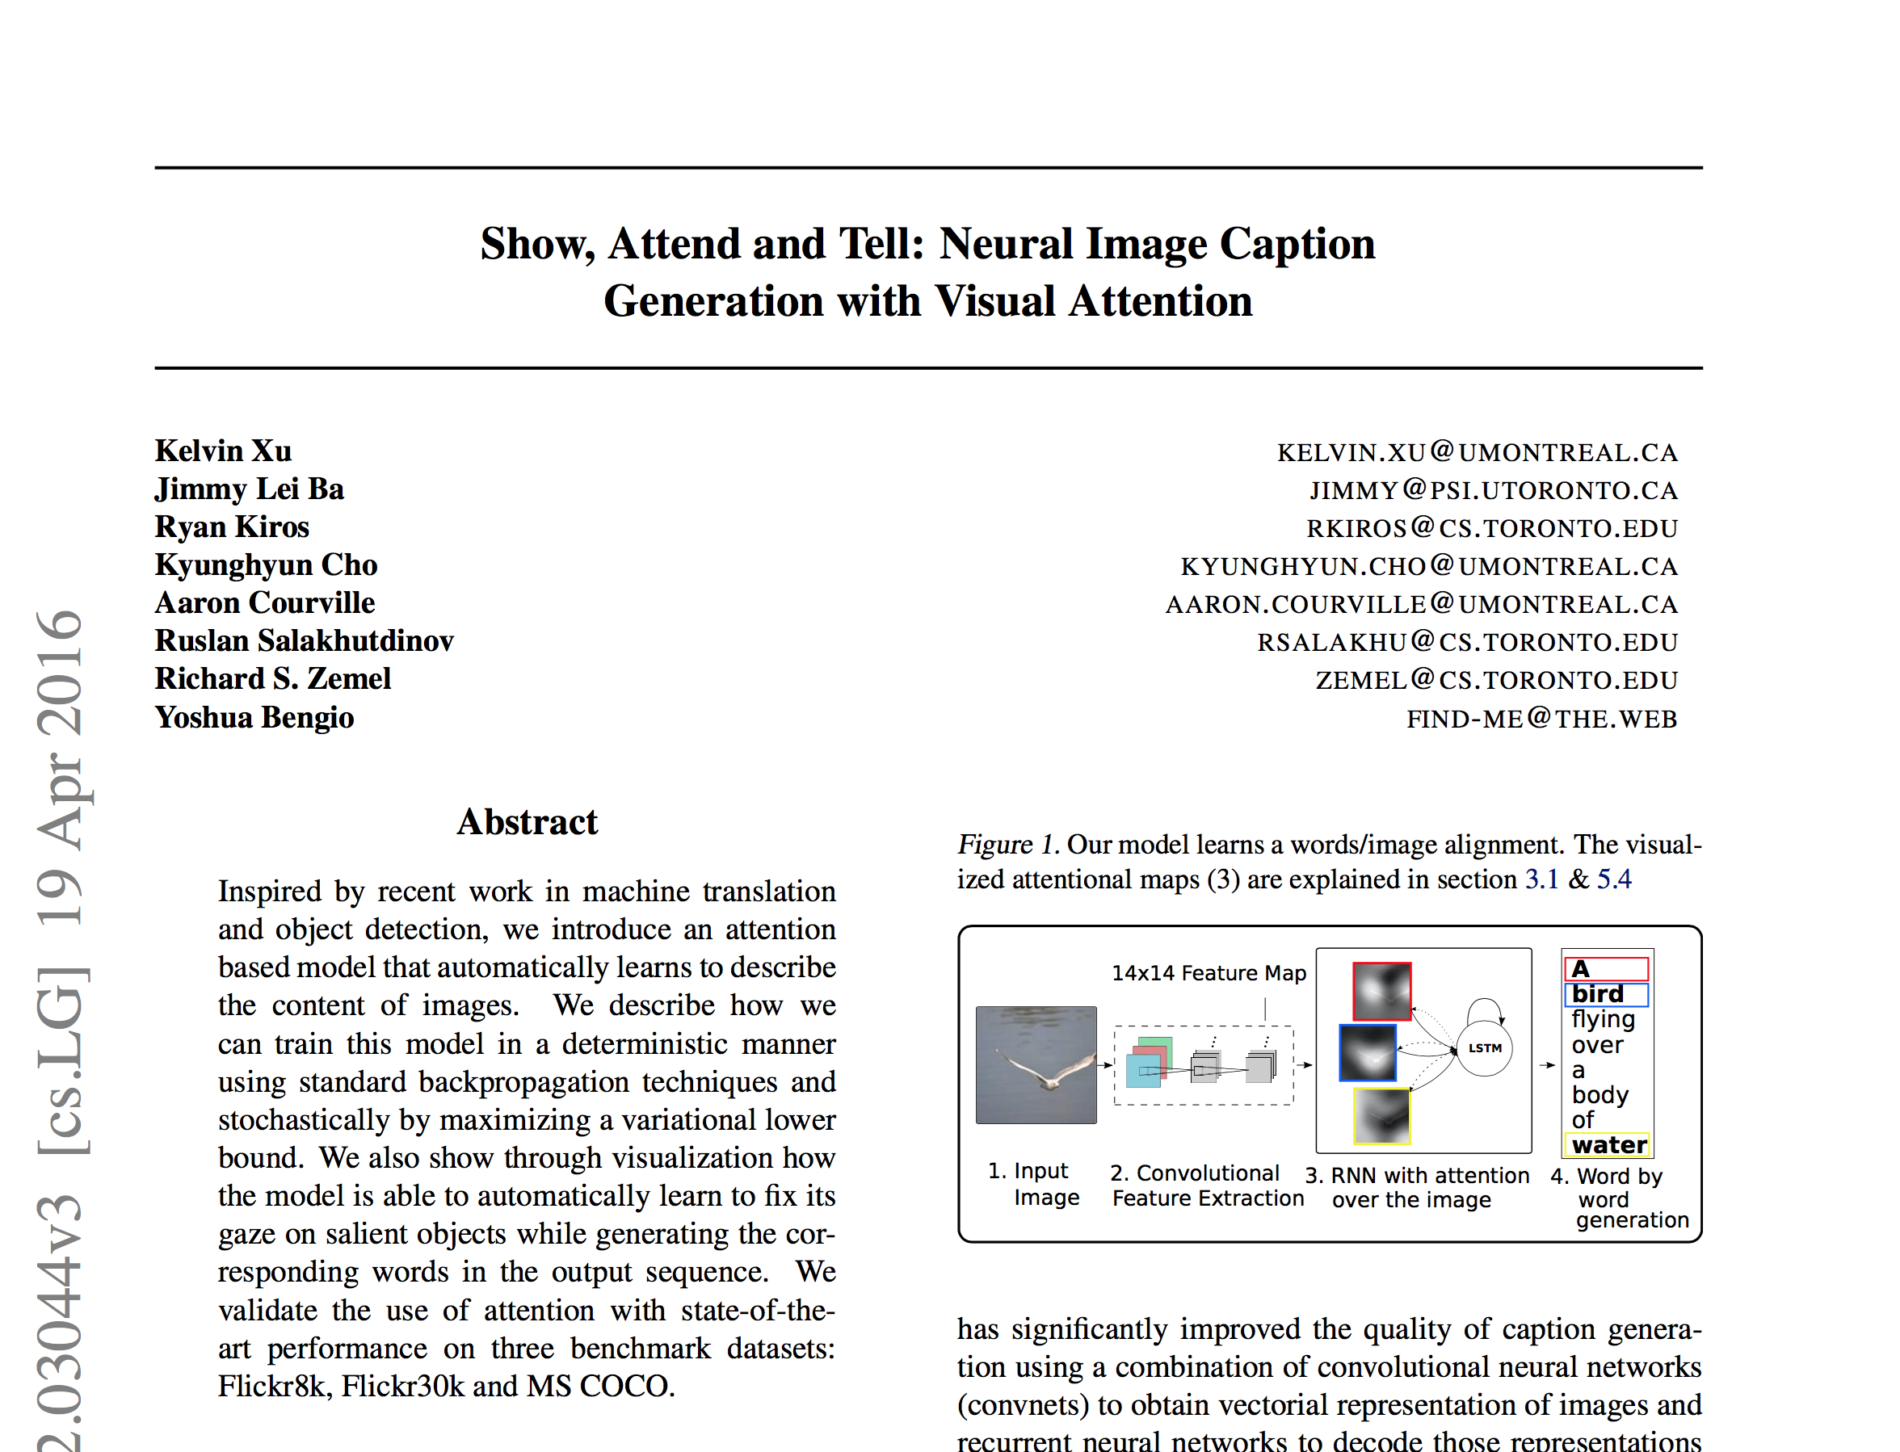

Slide 39
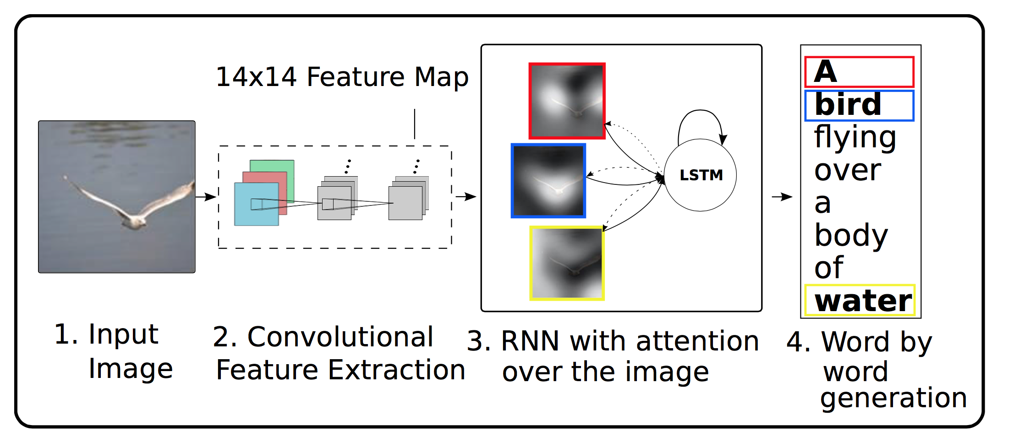
Show, attend and tell

Slide 40
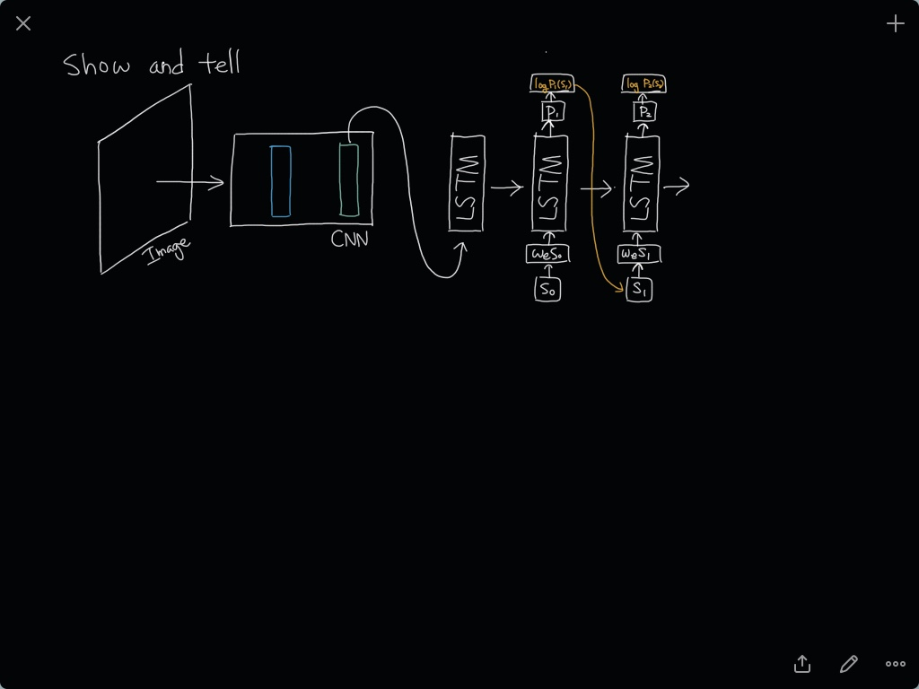

Slide 41
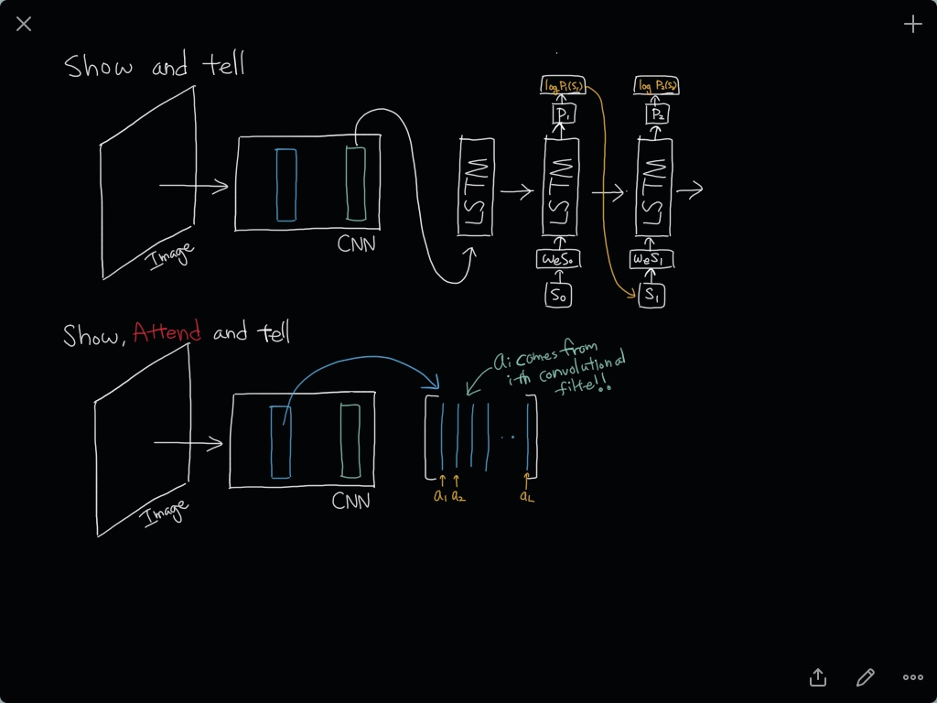
Notes:
a_i 가 채널 수 만큼 있는거: 각 단어를 말함에 따라서 어느번 째 채널을 봐야하는지 정해진다고 보면 된다.

Slide 42
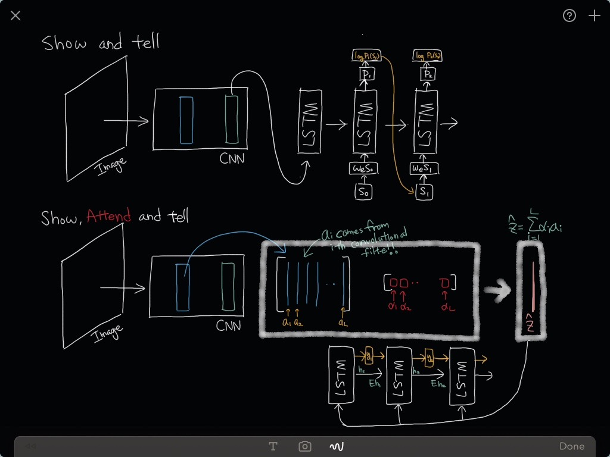
Notes:
알파i가 어텐션에 대한 weight

Slide 43
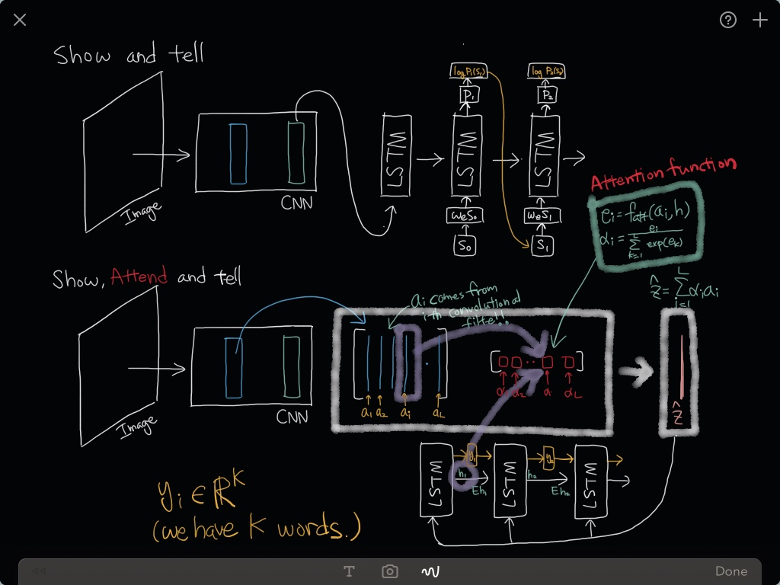
Notes:
단어 하나가 나오면 다음번에는 그 단어가 이제 필요 없으니 그 단어에 해당하는 a_i를 빼고 보겠다는 의미

Slide 44
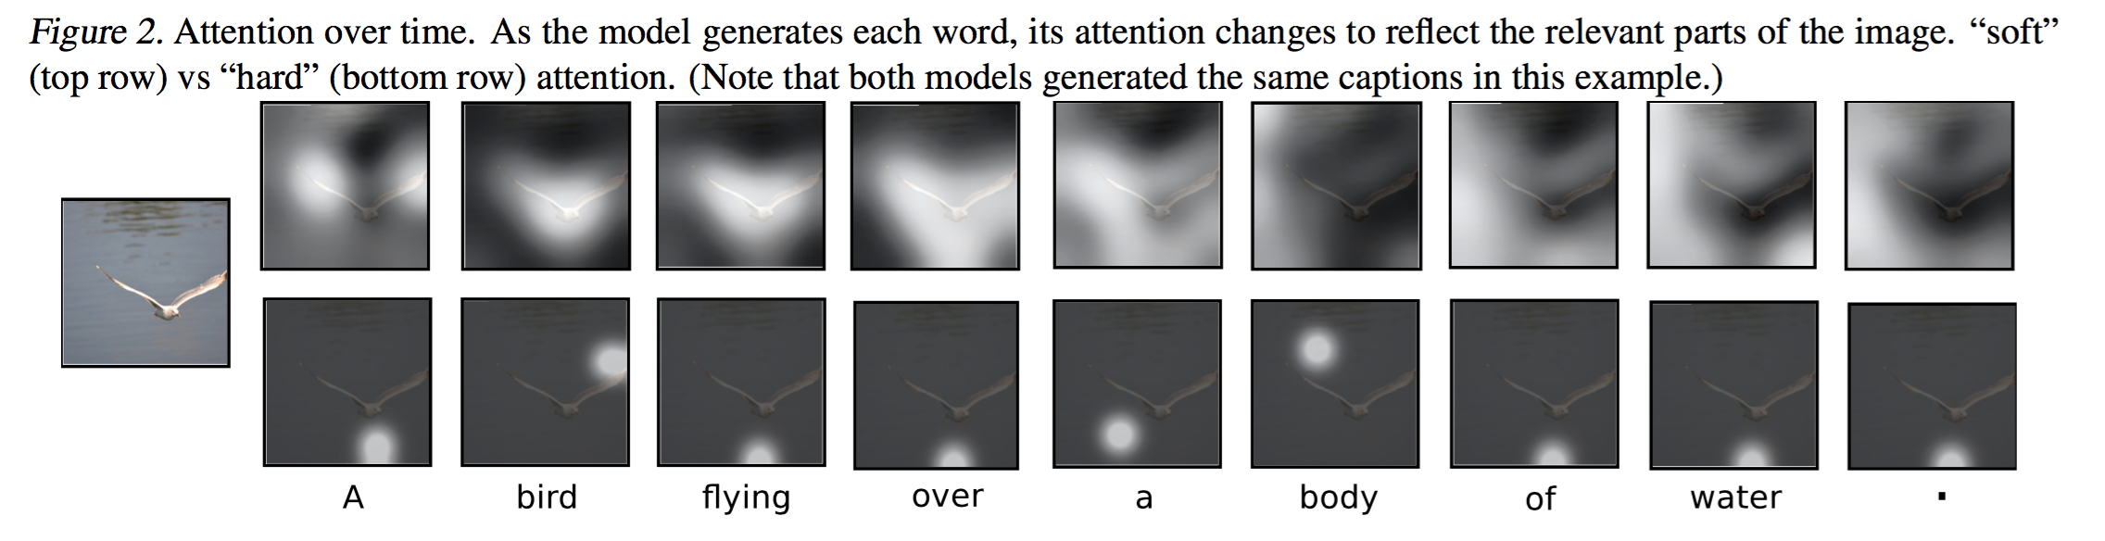
Results

Slide 45
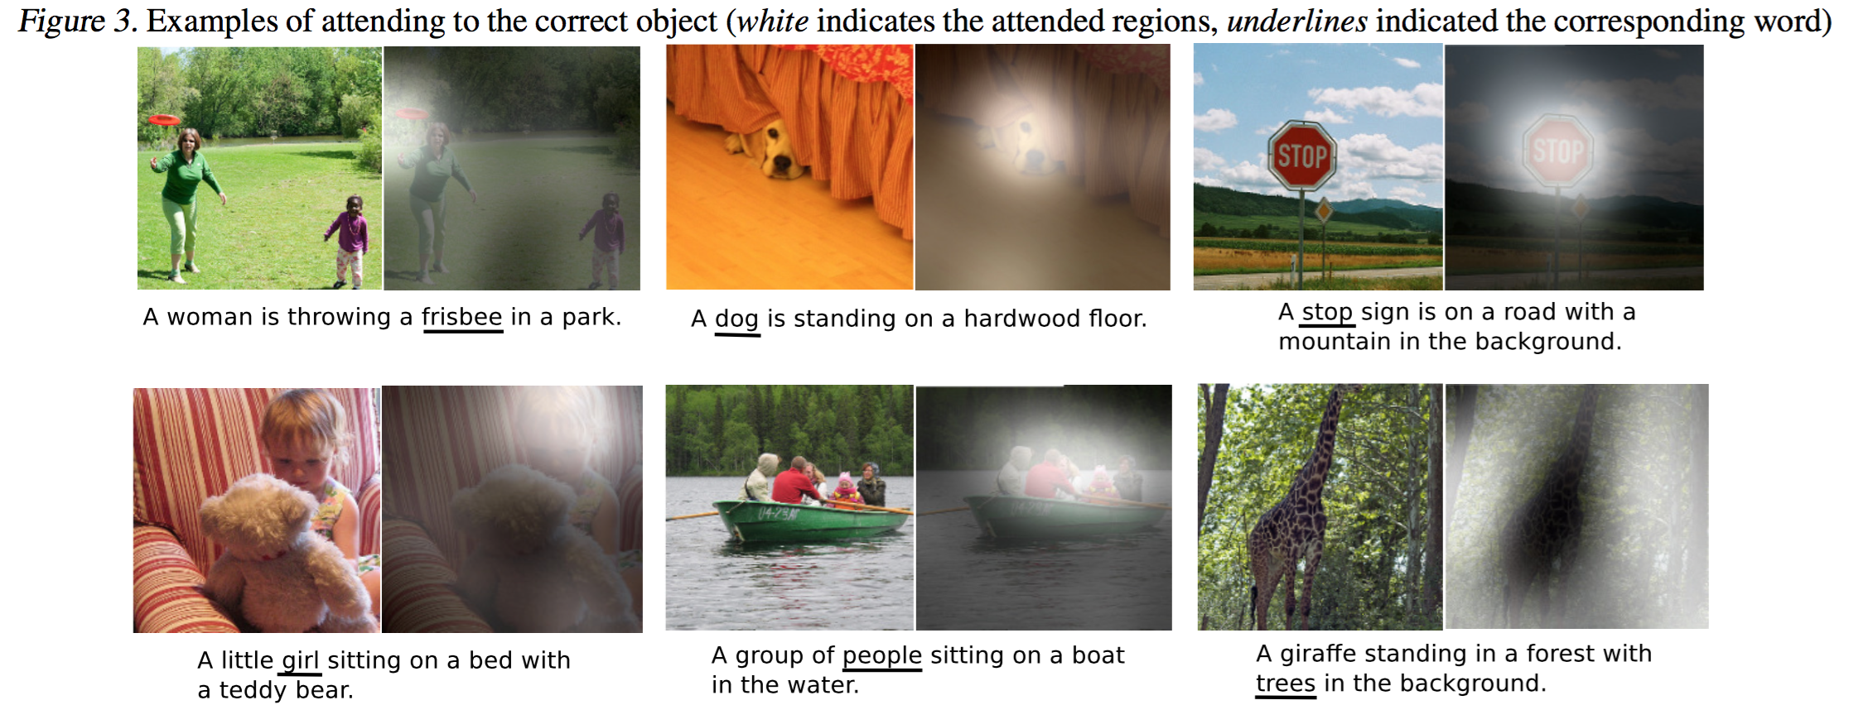
Results

Slide 46
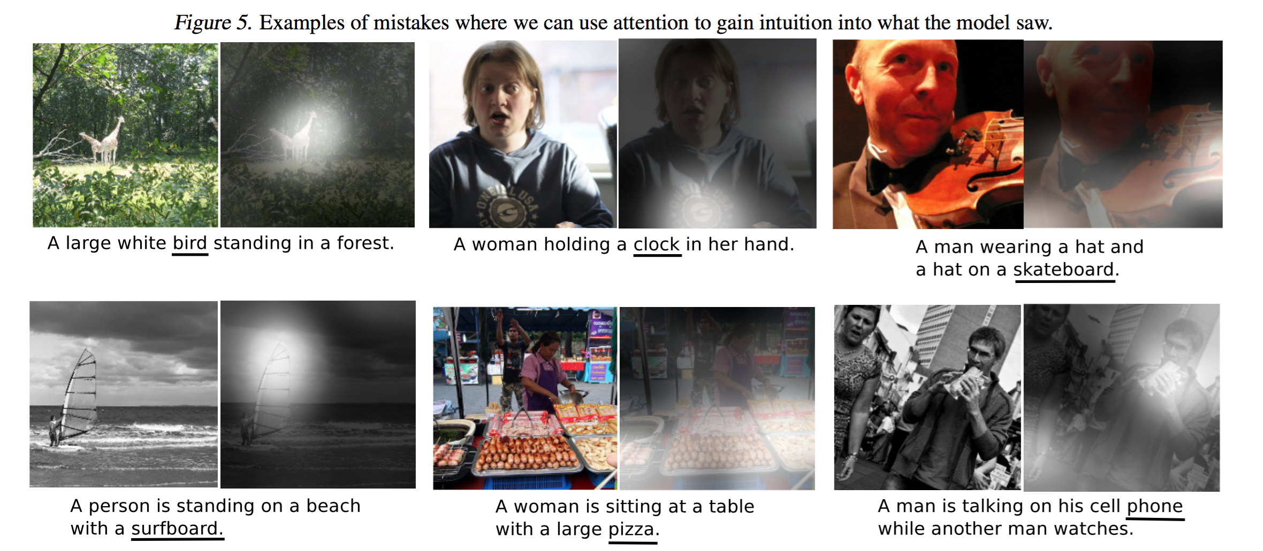
Results (mistakes)

Slide 47
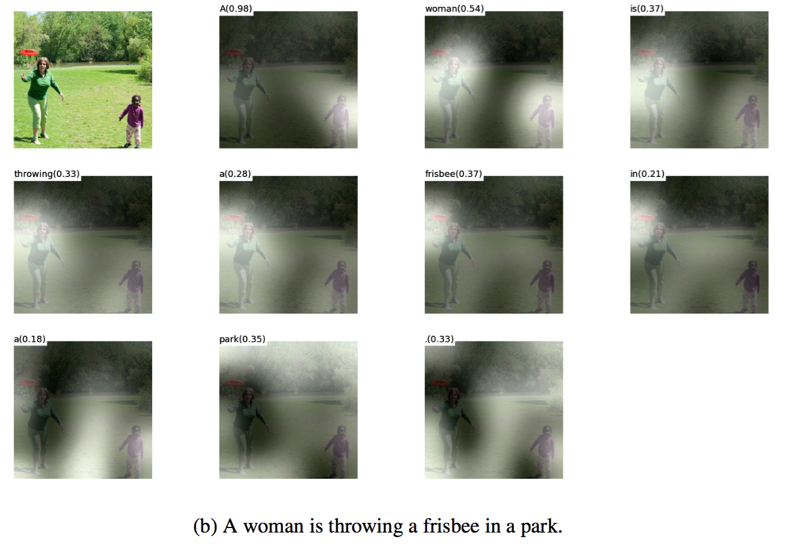
Results

Slide 48
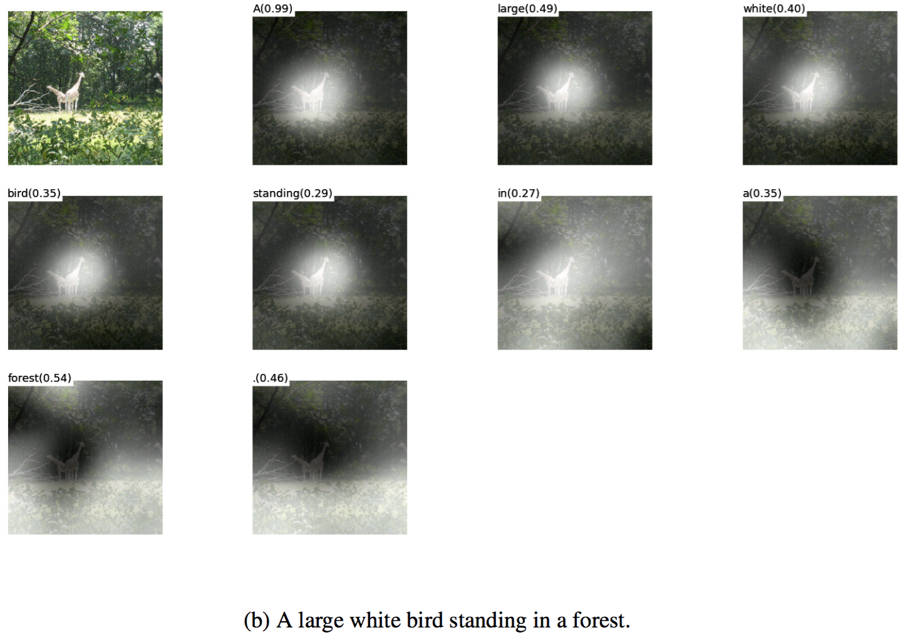
Results

Slide 49
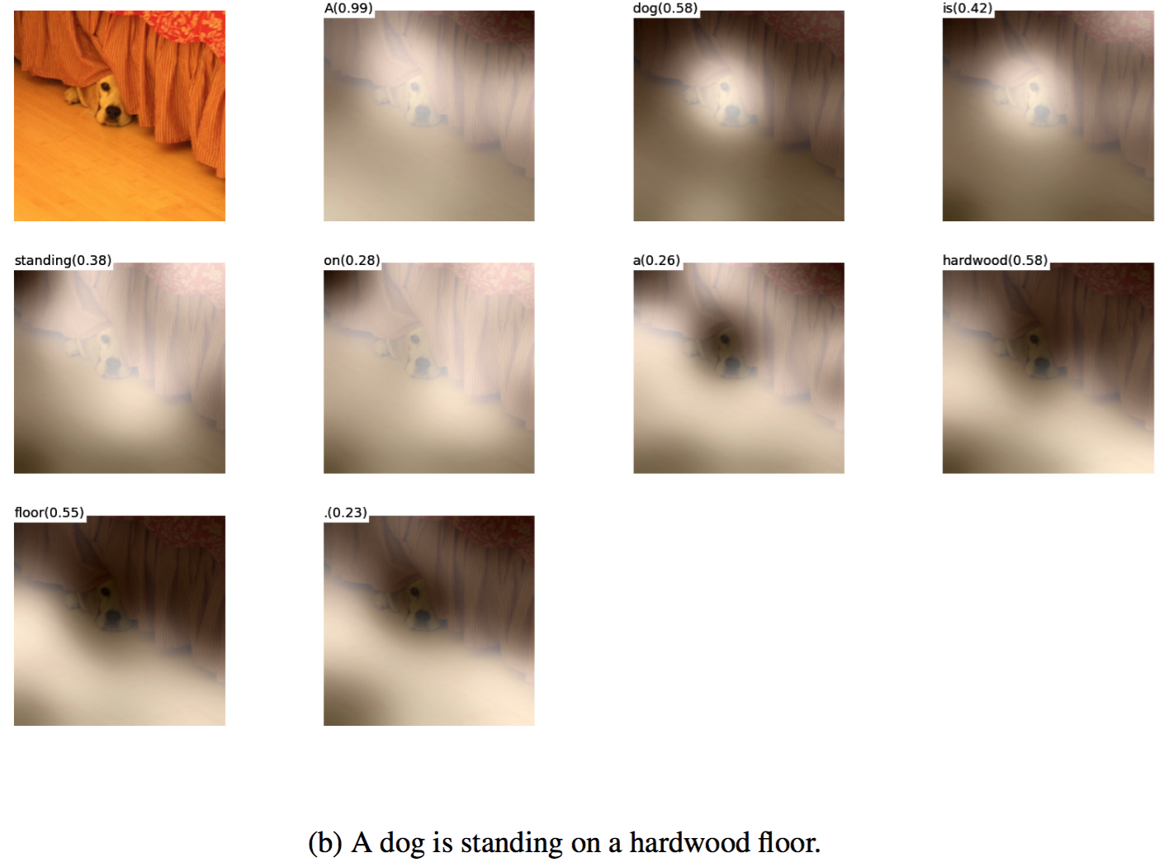
Results

Slide 50
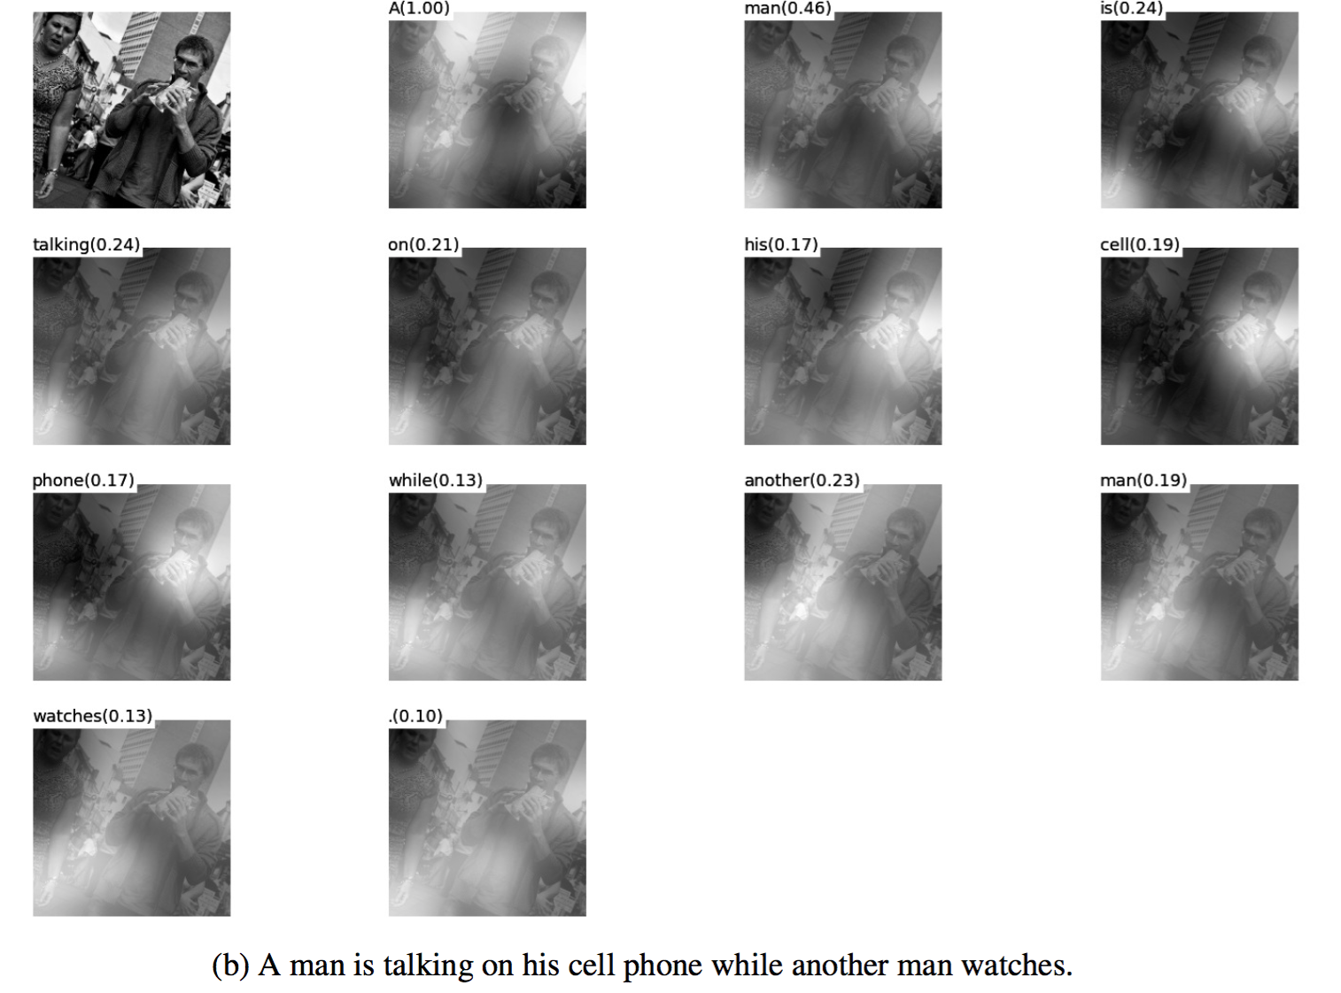
Results

Slide 51
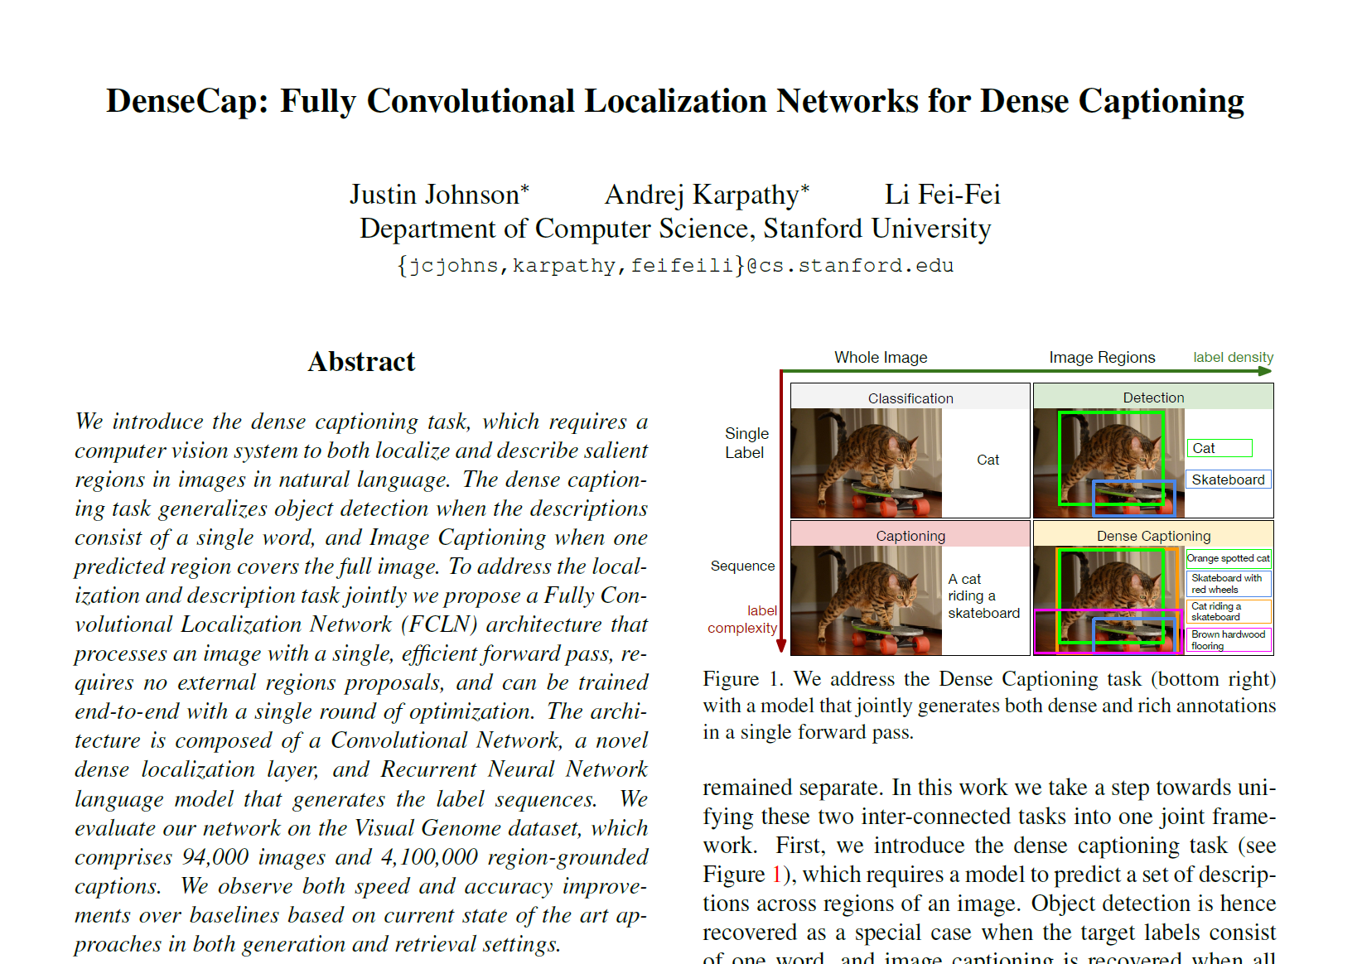

DenseCap
From TA Chang’s slide

Slide 52



Introduction
Classification
Object Detection
Image Captioning

Slide 53

Introduction

Slide 54

Examples of DenseCap

Slide 55

Examples of DenseCap

Slide 56
Contribution
Combine nicely three recent work in
Object detection
+ Image captioning
+ Soft spatial attention

Slide 57

Proposed model
Object detection
Image captioning
Soft spatial attention
Notes:
Region proposals라고 돼있는게 faster-rcnn의 RPN

Slide 58

Soft spatial attention
RoI Pulling layer
RPN (Faster R-CNN)
Soft spatial attention
Gradients can be propagate backward from the output features to input features,
But not to input proposal coordinates.

Slide 59


Differentiable image sampling
Jaderberg, Max, Karen Simonyan, and Andrew Zisserman. "Spatial transformer networks." NIPS. 2015.

Slide 60







Bilinear interpolation
$$G_{i,j}=\left(x_{i,j}, y_{i,j}\right)$$
Output dimension:
$$B×C×X×Y$$
Instead of $V_{c,i,j}=U\left(c,x_{i,j},y_{i,j}\right),$
1
1
$$d$$

Slide 61


Recognition network
Localization Layer
Recognition Network
Regularized using Dropout
$D=4096$
Refine confidence and position
Outputs a final scalar confidence of each proposal region
And four scalars encoding a final spatial offset

Slide 62


BRNN
BRNN
Words that appear $≤15 times$ $⇒$ Collapse to $<UNK>$ token
Strip referring phrase such as “there is …”, or “this seems to be a…”
Discard all annotations with more than 10 words
Discard all images that have $≤20$ or $>50$ annotations

Slide 63
Proposed architecture
Object detection
Image captioning
RPN (Faster R-CNN)
Soft spatial attention

Slide 64
Examples

Slide 65

Examples

Slide 66
Examples

Slide 67

Image retrieval

Slide 68
Open-world object detection

